Slide 1
Stem Cells
Carlo Brambilla, Stefano Di Modugno, Simone Galbiati, Luca Strada
2L Liceo delle Scienze Applicate
Anno Scolastico 2014 – 2015
CLIL PROJECT
Proff. Rossella Coppola (Scienze) Stefano Parisi (Inglese)

Slide 2
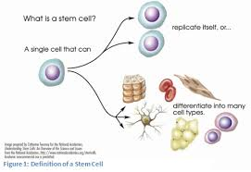
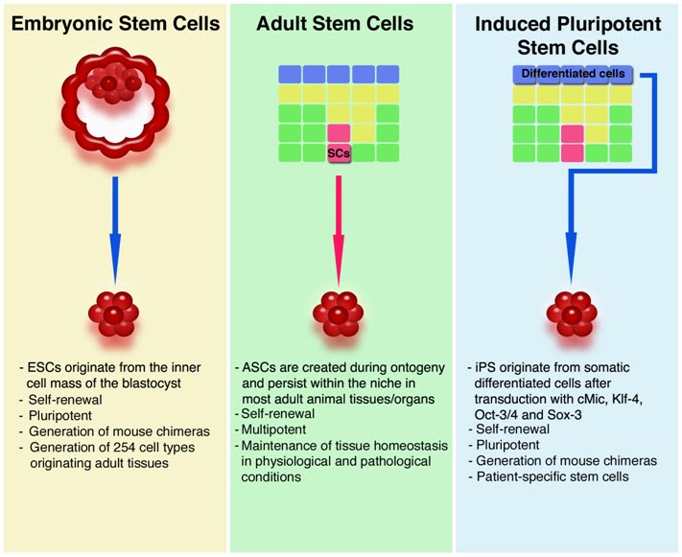
What are the similarities and differences between embryonic and adult stem cells?

Slide 3
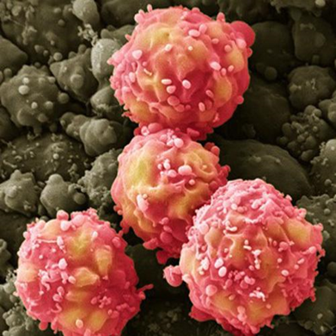
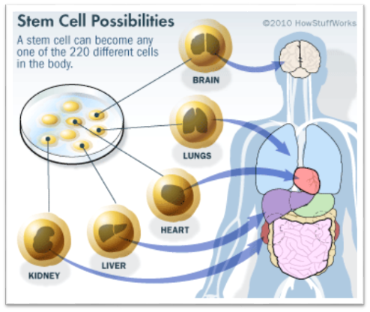
Where are adult stem cells found, and what do they normally do?

Slide 4
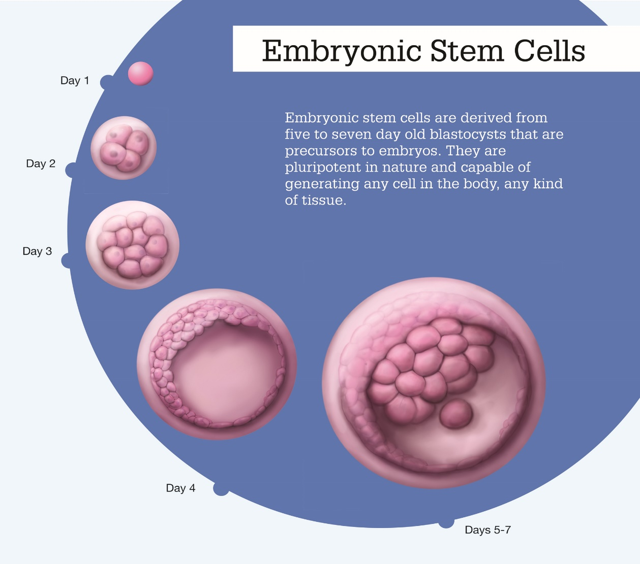
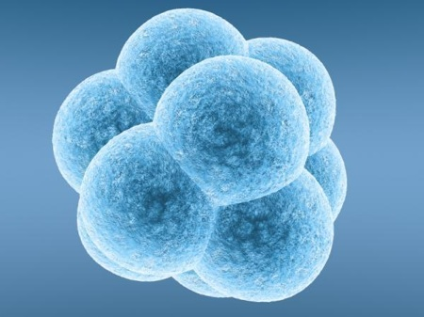
What stages of early embryonic development are important for generating embryonic stem cells?

Slide 5
Characteristics and properties
Strada Luca

Slide 6
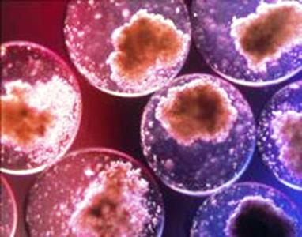
They are able to replicate infinitely
Unlike muscle cells, blood or nerve cells, the stem cells are able to replicate for numerous cycles.
If this process of replication is not carried out by the specialized cells, the stem cells perform self-maintenance capacity

Slide 7
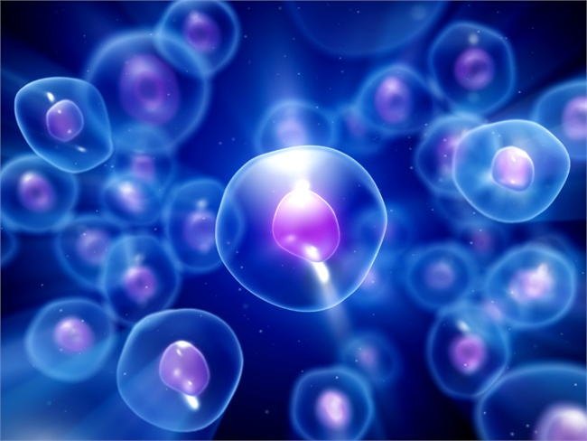
They are not specialized
One of the most important properties of these cells is absence of specific tissue structures that allow to perform specialized functions.
Unspecialized stem cells can develop into specialized cells.

Slide 8
They can produce specialized cells
Stem cells can produce specialized cells through a process called differentiation. This process is characterized by some internal and external signals, controlled by specific genes. It means that the contact with an adjacent specialized cell may influence the stem cell with specific molecules.

Slide 9
STEM CELL TRANSPLANTS
Galbiati Simone

Slide 10
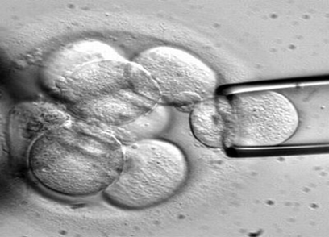
WHAT IS A TRANSPLANT?
A stem cell transplant is a procedure that allows to replace destroyed, diseased or damaged cells with healthy highly specialised cells taken from a donor.
The stem cell transplant can treat serious blood diseases as Aplastic Anemia, Acute Lymphocytic Leukemia and Acute Myelogenous Leukemia
The stem cell can convert itself into any kind of blood cell.
Example of a stem cell sample-taking

Slide 11
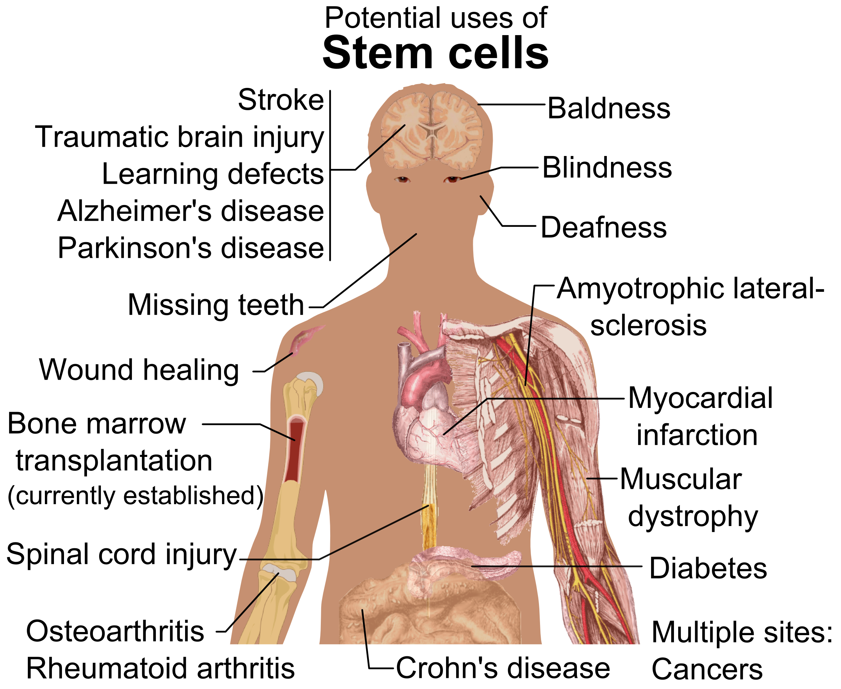
CELL TRANSPLANT
There are two types of stem cell transplant: the Allogeneic and the Autologous.
The Autologous is the oldest type. Now is not permitted in Italy and many other countries.
The Allogeneic is safer than the Autologous. It can treat the most diseases. It is the most used transplant in the world.

Slide 12
ALLOGENEIC OR AUTOLOGOUS?
AUTOLOGOUS TRANSPLANT
ALLOGENEIC TRANSPLANT
It is an unsafe type of transplant, can cause illness because the cells may be infected by other diseases.
the stem cells used for autologous transplant derived from the same individual who undergoes the transplant.
This type of transplant is now used only in few countries in the world and in Europe is illegal.
It is a safer transplant than the autologous, can prevent a lot of serious illness of the blood.
The stem cells derived from an external donator (a familiar person or a member of the International Donation Register)
This type of transplant requires an help of the chemiotherapy for fight the diseases.
It is practiced in a lot of countries included Italy.

Slide 13
STEM CELL APPLICATIONS
Stefano Di Modugno

Slide 14
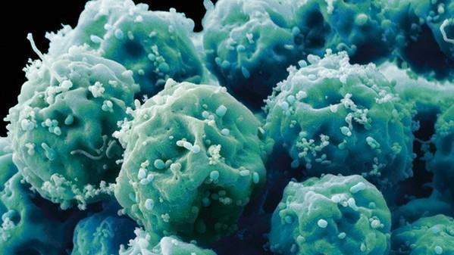
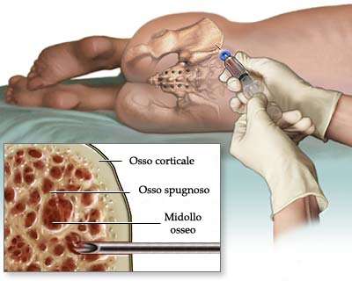
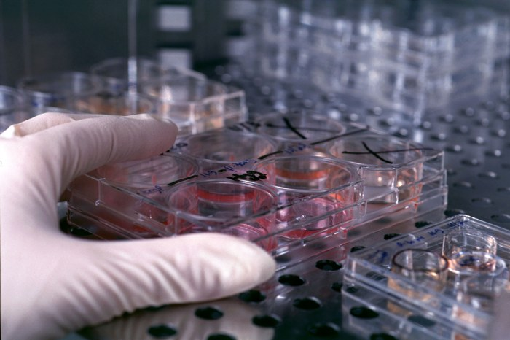
Applications
Stem cells are able to regenerate and restore the bone marrow and the immune system damaged by chemiotherapy and radiotherapy.
Umbilical cord blood stem cells can be multiplied more easily than the cells of the bone marrow and can be used up to 40 times.
10 cells can be created up to 10 trillion cells.

Slide 15
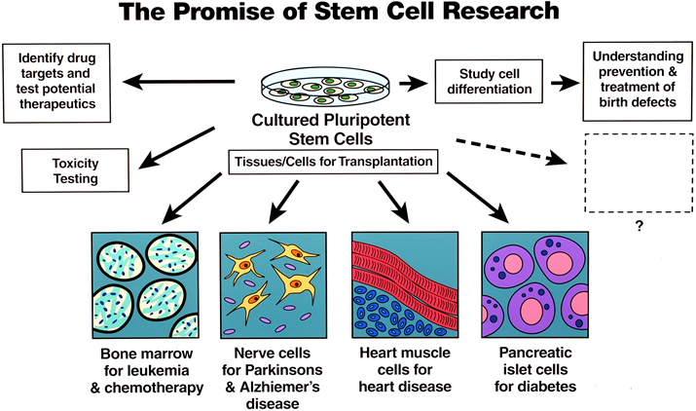
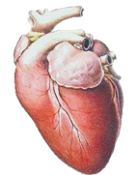
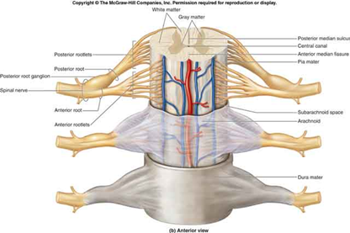
Applications
Pathologies
Brain damages and strokes (childhood trauma)
Autoimmune diseases (type 1 diabetes, lupus)
Spinal cord injuries
Cardiac and vascular strokes

