Slide 1
The Gastrointestinal Cells
Presentation by
Alessandra Cipriano, Lara Dalla Libera, Francesca Di Gennaro, Alessia Pelucchi.

Slide 2
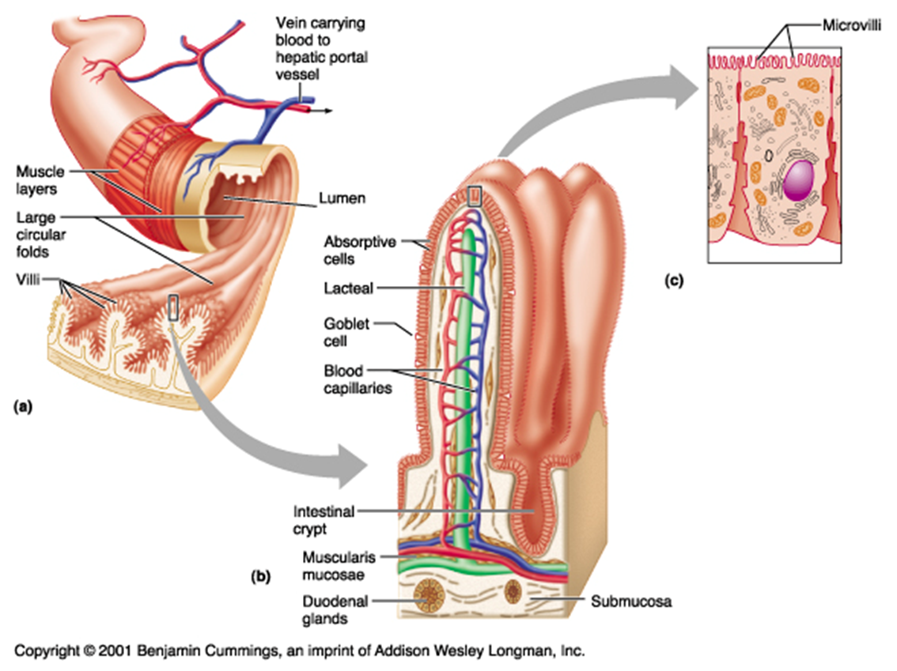
Digestive system and cells with microvilli
What is the digestive system?
What are its functions?
From what is made?
Cells with microvilli:

Slide 3
Types of tissues
Connective tissue
Smooth and striated muscle tissue
Epithelial tissue

Slide 4
Gastrointestinal pathologies
Gastritis
Peptic ulcer
Gastro-esophageal reflux
Barret's esophagus
Celiac disease
Cancer of the stomach and esophagus
Appendicitis

Slide 5
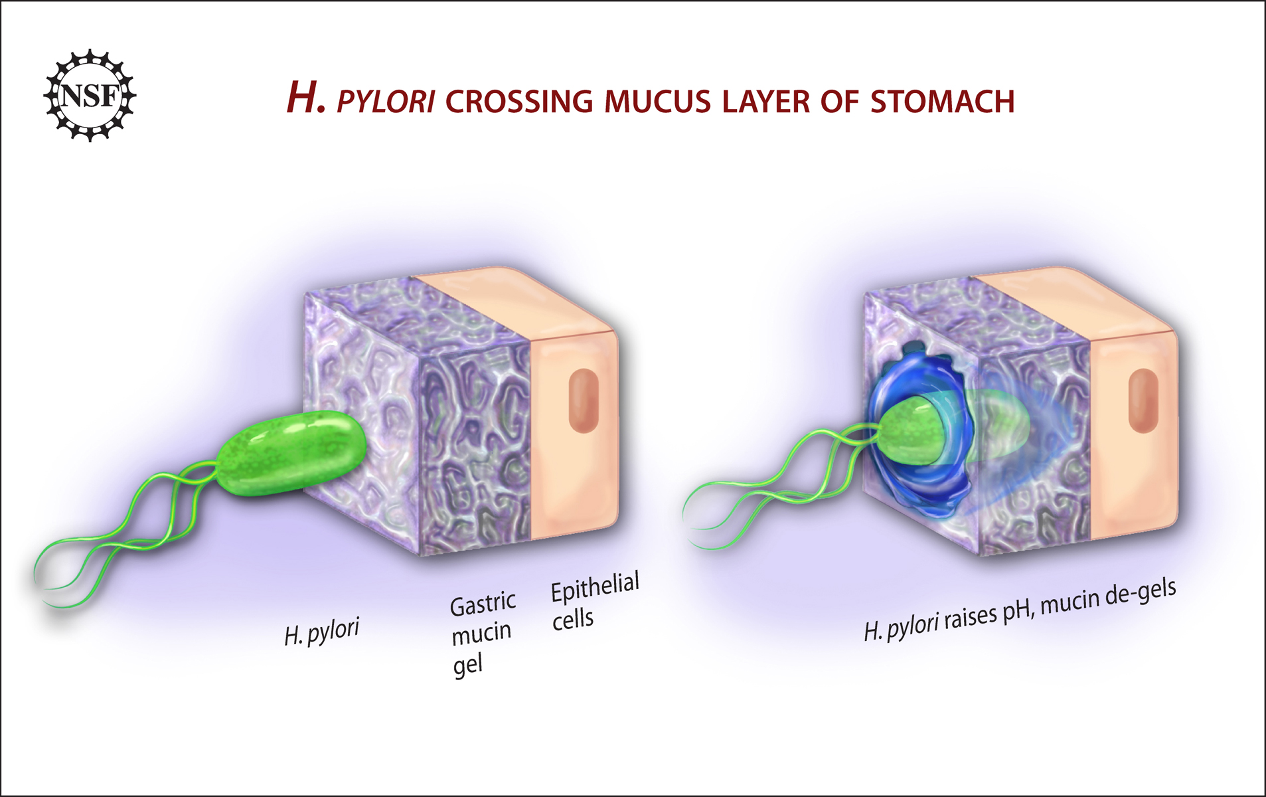
Main Treatments
Pharmacological treatments
Natural cures
The cause of most diseases
Antacids
Inhibitors
Protectors of the gastric mucosa
Antibiotics
Aloe vera gel
Chamomile
Liquorice
Peppermint
Malva

Slide 6
Thanks for your attention

