Slide 1
Nerve cells
ANATOMY - AXON & DENDRITE - MIRROR NEURONS - SYNAPSES

Slide 2
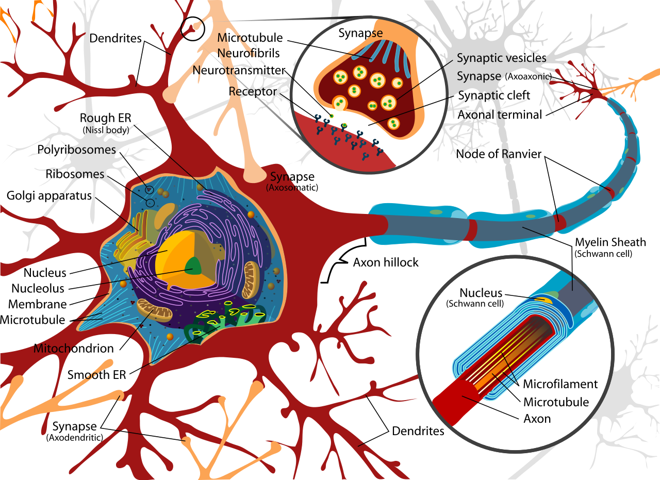
Anatomy
The neurons are the nerve cells involved in the production and exchange of signals. They represent the functional unit of the nervous system. The majority of the neurons is characterized by 3 main areas: the cell body (also called soma), the dendrites and the axons.
Notes:
The cell body is similar to any other kind of "standard" cell of the organism. Usually of spherical, pyramidal or star-like shape, body cell contains the nucleus and all the necessary organelles for the enzyme synthesis. The rough endoplasmic reticulum and Golgi apparatus are unusually developed, there are also many mitochondria.

Slide 3
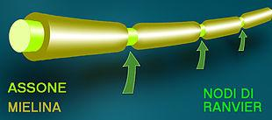
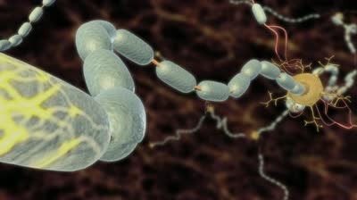
Axon
The axon is a conductor of pulses in centrifugal direction compared to the cell body.
Each neuron has only one axon. It is originated from the cell soma and it has a microscopic diameter of a few micrometers, but its length can be macroscopic.
Notes:
In the animalia kingdom there are two types of transmission:
Electric (Invertebrats and vertebrates)
Chemical (Vertebrates)

Slide 4
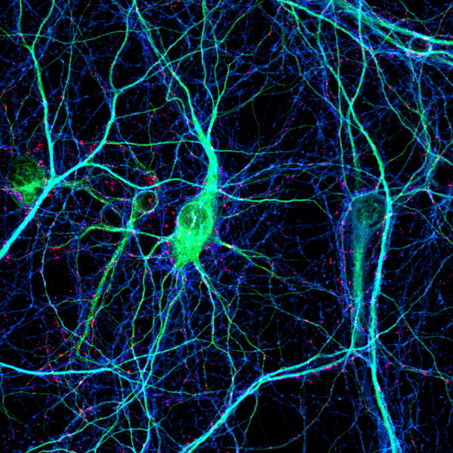
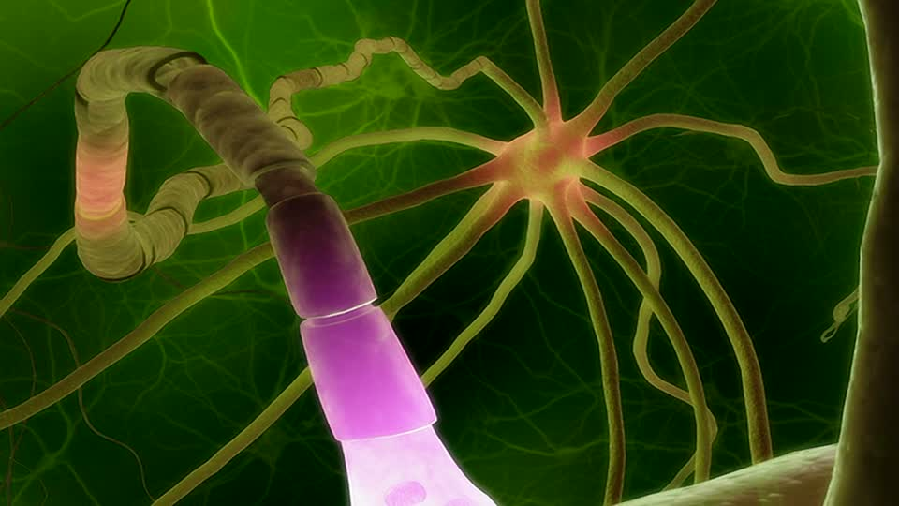
Dendrite
In biology are defined dendrites the minor fibers branching from the neuron, they carry nerve signals in centripetal direction. The dendrites are shorter and thinner than the axon.
Notes:
The major part of the neurons has an high number of dendrites. They can change shape and number because they’re normally specialized in a particular task.

Slide 5
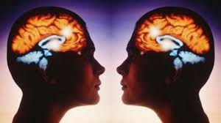
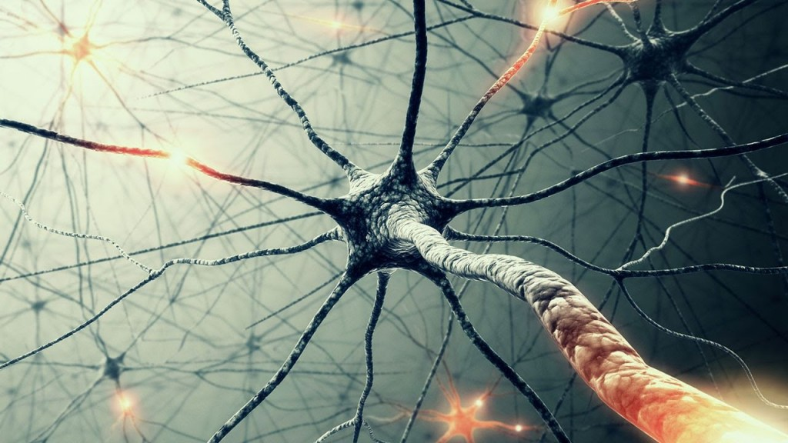
Mirror neurons
Mirror neurons are a class of neurons that are activated when a person (or animal) observes another person performing an action.
These neurons may be important for understanding the actions of others and then learning through imitation.
Notes:
Some researchers believe that the mirror system can simulate the observed actions and therefore contribute to a theory of knowledge, or, as some call it, theory of mind.

Slide 6
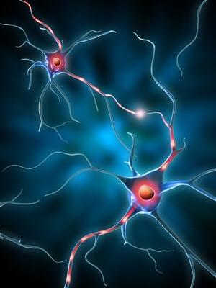
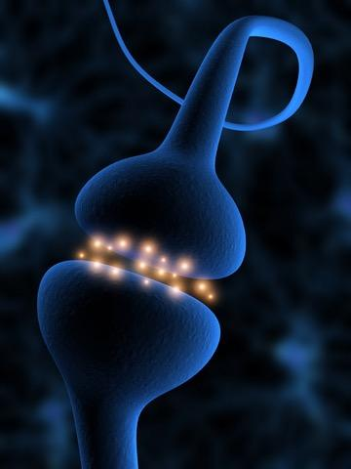
Synapses
The transfer of electrical signals between cells is carried out by specialized areas called synapses; the cell that sends the signal is the presynaptic cell while which receives it is the postsynaptic one. The space that separates the cells is said synaptic gap or
synaptic cleft.
Chemical action
It causes exocytosis of vesicles containing the neurotransmitter receptor that causes the cell to generate an electrical signal.
Electrical action
It passes directly from the presynaptic cell to the postsynaptic.
Notes:
Electrical: Although they are more present in invertebrates, they are also present in humans. In electrical synapse cells they are very close (2-4nm). Among the advantages of an electric synapses have its structural simplicity, its transmission rate and the low energy consumption; on the other hand it is not possible to elaborate the signal.
Chemical: In these synapses in contrast to those electrical, chemical synapses in the synaptic gap is relatively large (20-40 nm). The chemical synapse can proceed in one direction, and this is called rectifying.

Slide 7
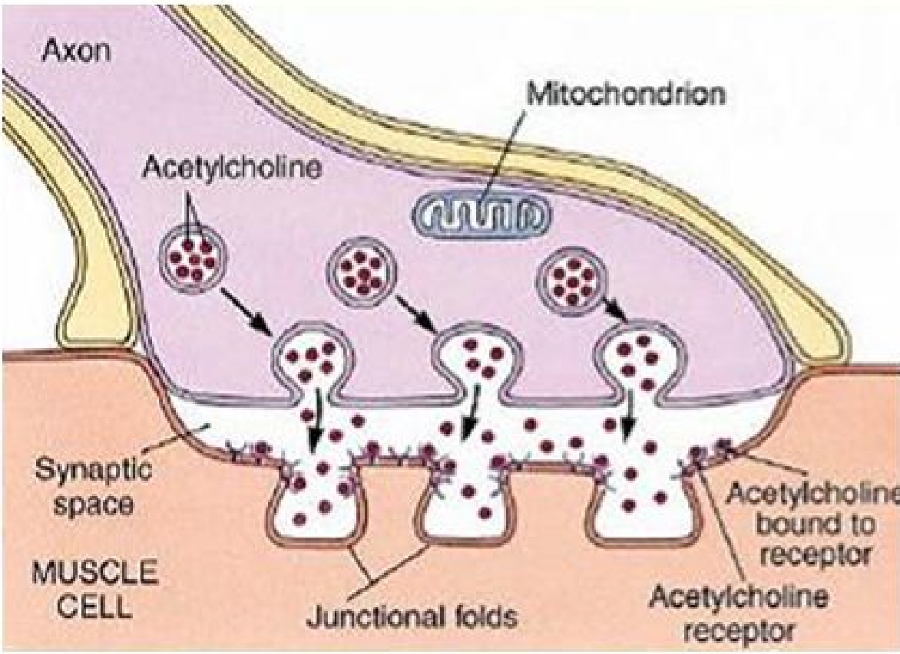
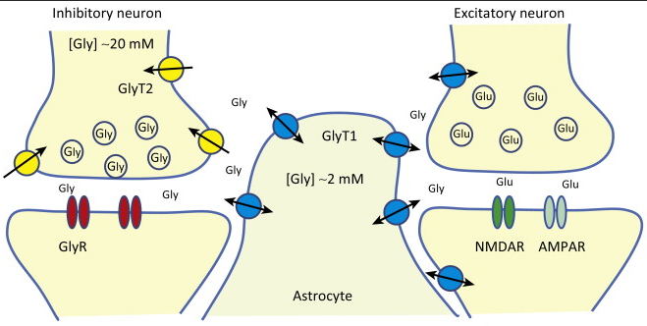
Synapses
Muscular action
A special case of a chemical synapse is the neuromuscular junction, in which the axon of a motor neuron terminates on a muscle fiber. In such cases, the released neurotransmitter is acetylcholine. This type is a faster and more direct synapse
Excitatory and inhibitory action
If the neurotransmitter causes depolarization (lost of potential energy), it is called excitatory synapses. If the neurotransmitter causes hyperpolarization (opposite case), the synapse is called inhibitory.

Slide 8
The end

