Slide 1
History CLIL: working with teachers and students
Anna Ballarino, Liceo Majorana, Desio

Slide 2
Outline
The work with teachers, first of all at Liceo Majorana and not only
The work I do with my students, in the classes
What I have learned from CLIL; and what I expect to learn

Slide 3
Working with teachers At Majorana
[Team CLIL]
2016/17: English Course
Focus on grammar and exercises
CLIL: suggestions of the lessons, review of the materials

Slide 4
Conditional exercises 2 maggio
If you aren’t going to live in that house, why don’t you sell it? If I had a house I couldn’t use, I would sell it at once.
The machine switches off if you press this button.
If you had not made so much noise last night, you would not have waken my little sister and she would not have started crying.
If I had known he was going to ring, I would have stayed at home.
If the camera is on, a red light appears.
If you do, will you please remind him?
What would have you done if you had not caught the train?
If I had one, I would grow plants in pots then my flat would be perfect.
Your car would not have broken of you had taken it
If you freeze water, it turns into ice.
Tell him to bring his bicycle inside. If he leaves it outside, someone will steal it
He is allowed to leave early today if he will stay later tomorrow.
Would you work harder if you were better paid?
If you didn't’ complain so much, you might be

Slide 5
Working with teachers At Majorana
2. Cooperation with the English Department
3. Collaboration with History and Philosophy teachers (modulo esterno)

Slide 6
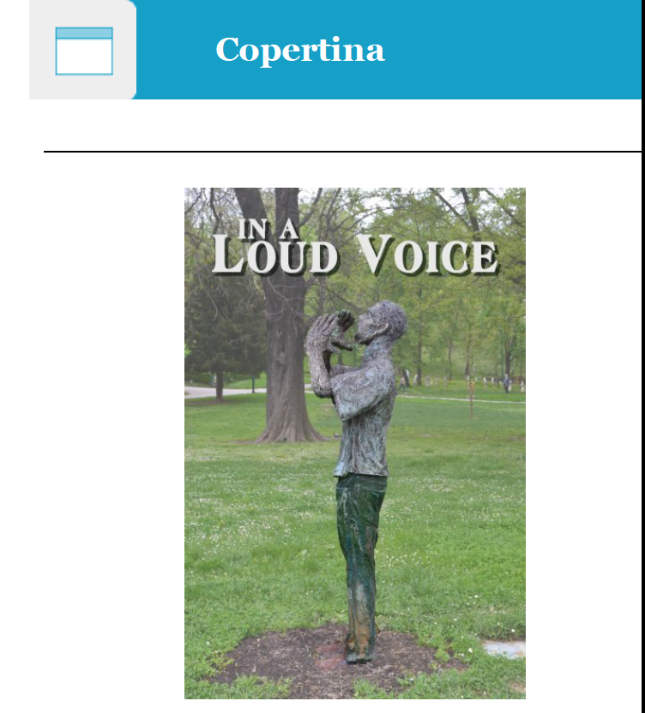
Working with teachers not only at Liceo Majorana
http://www.epubeditor.it/ebook/?static=78562

Slide 7
Working with students Example I: what do you know about?

Slide 8
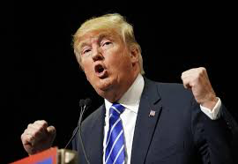
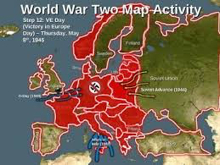
What do we know about …?
Political Speeches
World War 2
Movies
Trump
Rhetoric
Motivation
Movies
Winners-losers
Games
States involved

Slide 9
What do we know about the path to World War II? Match the event with the year
1939 (August)
1939
1936
1938
1938
1936-39
1939
Protectorate of Bohemia and Moravia
Policy of Appeasement (Neville Chamberlain)
Pact of Steel
Rome-Berlin Axis
Anschluss
Munich Conference
Treaty of Non-Aggression (Russia and Germany)

Slide 10
Working with students Example II: compare and contrast
Comparing and contrasting
Compare the 1940 Blood, Tears, Toil and Sweat speech by sir Winston Churchill with FDR’s speech. The context is different, but the appeal to the nation presents similar traits.
Can you compare the structure of the two speeches?
Do the two speakers make use of long or short sentences?
(…)
What do you think about the actual political speeches? Have you heard Trump’s speech?
Compare the 1940 Blood, Tears, Toil and Sweat speech by sir Winston Churchill with Kennedy’s speech. The urgency of war is different, but the appeal to the nation presents similar traits(…)
Do they make use of repetitions of concepts?
In your opinion, does the means of communication influence the message of the speeches?
And the way the speakers look like?

Slide 11
Working with students Example III: guess in a synthetic way
4th year students
Declaration of Independence and American Constitution Worksheet
Students listen to the Declaration and then complete the worksheet

Slide 13
Working with students Example IV: working in groups
Speaking
Working in groups
Think back over the movie The King’s Speech and the information you have about George VI’s reign. In two groups, discuss the king’s biography and his role in the war. Each group will be given a minute to share its ideas with the rest of the class.

Slide 14
Working with students Example V: FCE activities
Use of English
Match the following words to their corresponding definitions. One definition is extra
Threshold
Fateful
Pledge
To strip
Disguise
A real or imagined line that marks the limits of something
A serious promise
The entrance to a building or a room
Having an important effect
To remove
A thing that you wear to change your appearance
One extra definition allows student to do just one mistake instead of two

Slide 15
Working with students Example V: FCE activities
Vocabulary
Using dictionaries
1. Use a bilingual dictionary and find the correct translation for the following terms:
hint _____________________
onslaught _____________________
dastardly _____________________
2. Use a monolingual dictionary to discover the meaning and the use of the following terms:
maintenance ________________________________________________________________________
torpedoed ___________________________________________________________________________
might _________________________________________________________________________________
3. Use a dictionary or a thesaurus to find a synonym for the following words:
to attack _____________________________________________________________________________
to undertake _______________________________________________________________________
to overcome _______________________________________________________________________

Slide 16
Working with students Example V: FCE activities
Listening
https://www.youtube.com/watch?v=8TlkN-dcDCk
WSC, Blood, Sweat and Tears Speech, May 13th, 1940
Mister Speaker , on Friday evening last I received His Majesty's commission to form a new administration. It was the evident wish and will of Parliament and the nation that this should be conceived on the broadest possible basis and that it ________include all parties, both those who supported the late government and also the parties of the opposition. I have completed the most important part of this task. A war ________ has been formed of five members, representing, with the opposition liberals, the unity of the nation. The three party leaders have agreed to serve, either in the war cabinet or in high executive office. The three fighting services have been filled. It was necessary that this should be done in one single day, on account of the extreme urgency and rigour of events. A number of other positions, key positions, were filled yesterday, and I am submitting a further list to His Majesty tonight. I hope to ________ the appointment of the principal ministers during to-morrow. The appointment of the other ministers usually takes a little longer, but I trust that, when Parliament meets again, this part of my task will be ________, and that the administration will be complete in all respects.
(…)
Fill in the gaps
Complete the following text by choosing an appropriate word from the list below. One word does not fit.
of – should – complete – cabinet – us– connected – wage – move – however – to claim – affected – all costs – completed – necessary

Slide 17
Working with students Example V: FCE activities
Listening
David Bowie and the Wall
https://www.youtube.com/watch?v=uZiKOH9NXKc, 5.22
«Wir begrüßen alle unsere Freunde, die auf der anderen Seite der Mauer sind», from a concert in 1987 in front of the Reichstag.
https://www.youtube.com/watch?v=Tgcc5V9Hu3g
Write down the words about the wall and search (even Wikipedia) for the fact that inspired Bowie.

Slide 18
Working with students Feedback from graduates
1. What do you think were the main differences between the CLIL lessons and the Italian ones?
2. Were the CLIL lessons useful for your Esame di Stato?
3. Write down something you remember from your CLIL lessons, regarding the content.
4. You are now at your first university year: are you using the CLIL methodology in the academic lessons?
5. Last but not least: what would you suggest to your CLIL teacher?

Slide 19
Working with students Feedback from graduates
Peer to peer lectures with your teacher (V); Lessons more interactive and dynamic (S).
Capability of ranging from one subject to another (D).
Churchill (V, S, D); Second World War (C).
The capability of staying at pace with the professors (D).
Illustrating the arguments slowly and giving the students a more detailed book (S).

Slide 20
What I have learned, what I need to improve
The more you see, the less you know
The less you find out as you go
The more you know, the less you feel
Some pray for what others steal
I love students and I love my subjects. I understood that teaching some topics in English could help both the students and the topics

Slide 21
Thanks!

