Slide 1
TEACHING PHYSICS USING CLIL
Matteo Erba
Liceo Statale Scientifico e Classico
«Ettore Majorana»
Desio

Slide 2
CLIL PHYSICS LESSONS (2017-18)
LICEO SCIENTIFICO
(5B)
LICEO CLASSICO
(2a-3a-4a)
LICEO CLASSICO
(5a)
SECOND GRADE: GEOMETRY (6h)
THIRD GRADE: ENERGY (10 h)
FOURTH GRADE:
THERMODYNAMICS (10 h)
WAVES (10 h)
FIFTH GRADE: 80% OF LESSON TIME,
(50 h)
ELECTRIC CURRENT,
MAGNETISM,
E.M. INDUCTION,
OPTICS
FIFTH GRADE:
QUANTUM MECHANICS
(13 h)

Slide 3
TODAY’S PRESENTATION
INTRODUCE THE LESSON PLAN OF A TYPICAL CLIL LESSON ABOUT OHM’S LAW
POWER POINT PRESENTATION ABOUT OHM’S LAW
PRESENT SEVERAL DIFFERENT CLIL ACTIVITIES USEFUL TO PREPARE A LESSON

Slide 4
PREPARE A CLIL LESSON
1) TOPIC
2) OBJECTIVES
3) PREREQUISITES
4) LEVEL
5) LANGUAGE SKILLS
6) TIME
7) MATERIALS
8) LESSON PLAN

Slide 5
8) LESSON PLAN
1) INTRODUCTION:
- ASK QUESTIONS ABOUT
PREVIOUS LESSON
- CORRECT HOMEWORK
- IF IT IS THE FIRST LESSON, ASK GENERAL QUESTIONS
AND DISCUSS TOPIC OR USE KWL GRID. (5 MIN)
2) GLOSSARY EXERCISE:
- MATCHING AND GAP FILL (5-10 MIN)
3) SHORT LECTURE:
- ABOUT TOPIC USING POWERPOINT (15 MIN)
4) GROUP WORK WITH ACTIVITIES ON TOPIC (20 MIN)
5) VIDEO OR TEXT ON TOPIC WITH ACTIVITIES (10 MIN)
6) ASSIGN HOMEWORK : ACTIVITIES AND EXERCISES
AND / OR ORIGINAL TEXT TO READ ON TOPIC

Slide 6
1) INTRODUCTION
INITIAL ACTIVITIES TO START A LESSON
LAST LESSON…
Discuss with students what they learned during the last lesson, ask to write down at least three things they learned.
CORRECT HOMEWORK
OPENING QUESTIONS
Write on the whiteboard three questions about topics of the previous lesson: e.g.: one text based question, one question that requires application of studied topics and a challenging question.

Slide 7
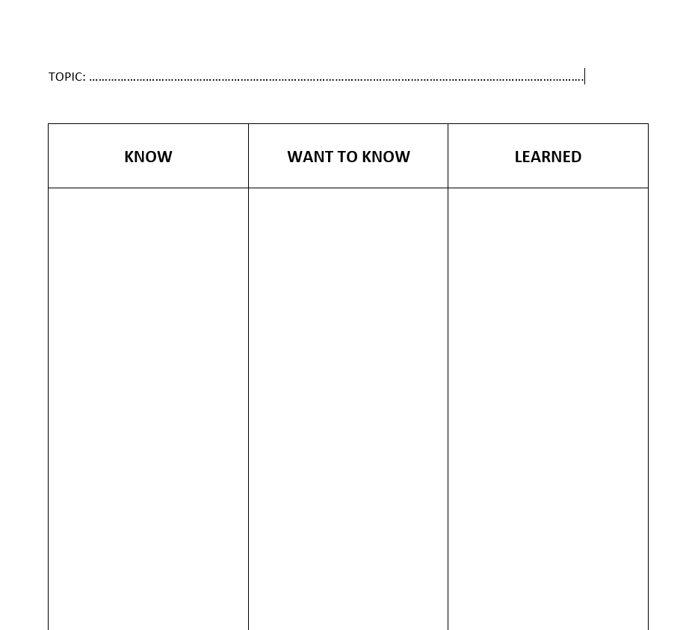
1) INTRODUCTION
INITIAL ACTIVITIES TO START A LESSON ON A NEW TOPIC: KWL GRID
KNOW
WANT TO KNOW
LEARNED

Slide 8
2) GLOSSARY EXERCISE
BEFORE THE PRESENTATION, IT CAN BE USEFUL TO CARRY OUT A GLOSSARY EXERCISE
MATCH WORDS WITH THEIR MEANING
THEN GAP FILL EXERCISE WITH THE SAME WORD LIST
THIS IS BETTER THAN THE USUAL ITALIAN-ENGLISH GLOSSARY AT THE END OF CHAPTER/BOOK

Slide 9
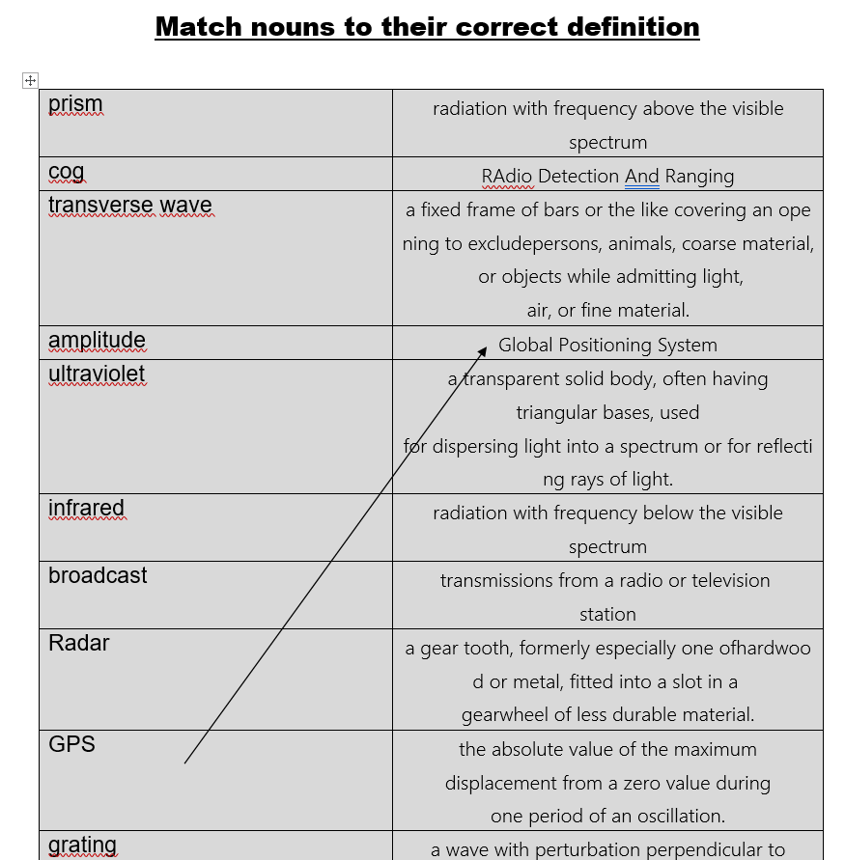

Slide 10
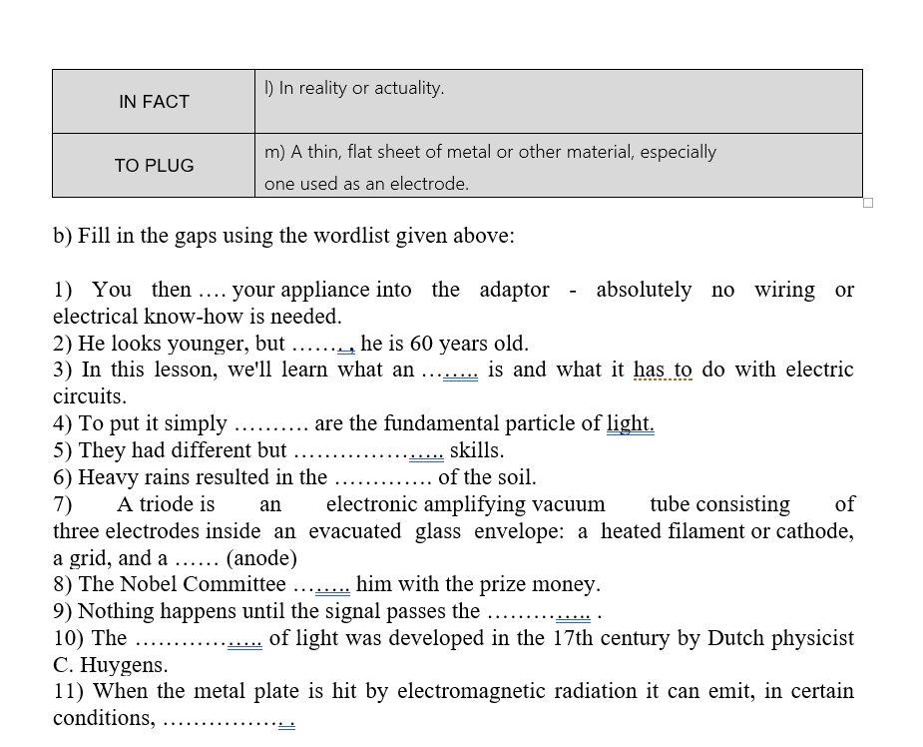
THE MATCHING EXERCISE CAN BE FOLLOWED BY A GAP FILL EXERCISE WHERE THE SAME WORDS ARE USED.

Slide 11
ENGLISH-
ITALIAN GLOSSARY:
USED ONLY FOR
TECHNICAL WORDS

Slide 12
3) LECTURE ABOUT OHM’S LAW

Slide 13
LESSON STRUCTURE
TO INTRODUCE OHM’S LAW
TO UNDERSTAND THE CONCEPTS OF RESISTANCE AND RESISTIVITY
TO DESCRIBE THE PROPERTIES OF OHMIC MATERIALS.
TO DESCRIBE THE PROPERTIES OF NON-OHMIC MATERIALS.
TO SHOW HOW THESE MATERIALS ARE IMPORTANT IN EVERYDAY LIFE.

Slide 14
OHM’S LAW

Slide 15
LEYDA JAR
IT WAS USED IN THE 18TH CENTURY TO GENERATE SHORT SPARKS
TODAY WE KNOW THAT IT IS A CAPACITOR, NOT A BATTERY

Slide 16
VOLTA’S BATTERY
VOLTA’S BATTERY (OR PILE) CONSISTS OF TWO ELECTRODES, ONE MADE OF COPPER AND THE OTHER ONE MADE OF ZINC
THE ELECTRODES ARE IMMERSED IN AN ELECTROLYTE (SULFURIC ACID)

Slide 17
VOLTA’S BATTERY
- THE BATTERY CAN KEEP A CONSTANT POTENTIAL
DIFFERENCE BETWEEN THE ELECTRODES EVEN WHEN THERY ARE
CONNECTED BY A WIRE
THE POTENTIAL DIFFERENCE REMAINS CONSTANT BECAUSE OF
CHEMICAL REACTIONS TAKING PLACE INSIDE THE BATTERY
IN THE WIRE A DIRECT (I.E. CONSTANT OR STEADY) CURRENT
(DC CURRENT) CAN FLOW FOR A LONG TIME

Slide 18
USING DIFFERENT BATTERIES WE CAN MEASURE THE CURRENT THAT FLOWS IN DIFFERENT TYPES OF WIRES
SIMPLEST CIRCUIT
BATTERY SYMBOL

Slide 19
CHARGE CARRIERS INSIDE A METAL WIRE ARE ELECTRONS, WHICH ARE NEGATIVELY CHARGED
HOWEVER, FOR HISTORICAL REASONS, CURRENTS ARE INDICATED IN CIRCUITS AS IF THEY WERE DUE TO A POSITIVE CHARGE FLOW

Slide 20
WE PLOT CURRENT i ON THE Y-AXIS AND THE POTENTIAL DIFFERENCE V ON THE X-AXIS
WE OBTAIN AN i-V CURVE

Slide 21
EXPERIMENTS SHOW THAT POTENTIAL DIFFERENCE (OR APPLIED VOLTAGE) AND CURRENT ARE DIRECTLY PROPORTIONAL
$$ΔV∝i$$
WE CALL RESISTANCE R THE PROPORTIONALITY CONSTANT
THE EQUATION WE OBTAIN IS CALLED OHM’S LAW
$ΔV=i∙$R

Slide 22
WE CAN REWRITE OHM’S LAW IN THE FOLLOWING WAY:
$$R=\frac{ΔV}{i}$$
THE ABOVE EQUATION IS CONSIDERED AS A DEFINITON OF RESISTANCE
RESISTANCE IS MEASURED IN V/A , WHICH IS CALLED OHM (SYMBOL: Ω)

Slide 23
A CIRCUIT ELEMENT THROUGH WHICH A CURRENT FLOWS IS CALLED RESISTOR
A NUMBER OR A COLOR CODE INDICATES THE VALUE OF THE RESISTOR IN Ω

Slide 24
OHMIC CONDUCTORS: CONDUCTORS THAT FOLLOW OHM’S LAW
METALS
GRAPHITE

Slide 25
NON-OHMIC CONDUCTORS

Slide 26
NON-OHMIC CONDUCTORS
Diode
RESISTANCE CAN BE COMPUTED ALSO FOR NON-OHMIC CONDUCTORS USING THE FORMULA R=V/I
Semiconductors
Electrolytic cell
Light bulb filament

Slide 27
Example 2
A metal wire carries a current of 1.5 A when a voltage of 220 V is applied to it. If we apply the same potential difference to a piece of wood we measure a current of 40 mA.
What is the resistance of the wire?
What current flows through the metal wire if we apply a voltage of 400 V?
Repeat points a) and b) for the piece of wood.

Slide 28
RESISTIVITY
RESISTANCE APPLIES TO OBJECTS, RESISTIVITY APPLIES TO MATERIALS
RESISTIVITY DEFINITION
$$ρ=R∙\frac{A}{𝓁}$$

Slide 29
RESISTIVITY IS MEASURED IN Ω∙m
SOLVING THE PREVIOUS FORMULA FOR RESISTANCE R WE OBTAIN:
$$R=ρ∙\frac{𝓁}{S}$$
NOTE THAT THE RESISTANCE OF A THIN WIRE
IS GREATER THAN THE RESISTANCE OF A THICK
WIRE

Slide 30
RESISTIVITY VARIES WIDELY IN DIFFERENT MATERIALS

Slide 32
RESISTIVITY CHANGES WITH TEMPERATURE, USUALLY INCREASING
THIS IS WHY A LAMP WIRE IS NOT AN OHMIC CONDUCTOR

Slide 33
SUPERCONDUCTIVITY
WHEN TEMPERATURE IS CLOSE TO ABSOLUTE ZERO (LIQUID HELIUM), METAL RESISTIVITY DROPS RAPIDLY TO ZERO
THIS PHENOMENON CAN ONLY BE EXPLAINED USING QUANTUM MECHANICS

Slide 34
SUPERCONDUCTIVITY
TODAY SUPERCONDUCTIVITY HAS BEEN ACHIEVED ALSO AT HIGHER TEMPERATURES (134 K = -139 °C , LIQUID NITROGEN)
SUPERCONDUCTING MATERIALS HAVE INTERESTING PROPERTIES
THEY CAN LEVITATE INSIDE AN EXTERNAL MAGNETIC FIELD

Slide 35
END OF POWER POINT PRESENTATION

Slide 36
4) GROUP WORK WITH ACTIVITIES

Slide 37
CLIL ACTIVITIES
CLIL ACTIVITIES ARE THE CENTRAL PART OF EVERY CLIL LESSON
BIBLIOGRAPHY:
A new planet - Percorsi disciplinari e per il CLIL, Spiazzi M., Tavella M., Zanichelli (2006)
Mathematics, Meyrick C., Roberts J., Oxford (2010)
Clil Activities - A resource for subject and language teachers, Dale L., Tanner R., Cambridge (2012).

Slide 38
CLIL ACTIVITIES
CLIL ACTIVITIES MUST TAKE THE ENGLISH LANGUAGE CURRICULUM INTO ACCOUNT (CHECK WITH ENGLISH TEACHER)
2ND GRADE: MODAL VERBS (MUST, CAN , SHOULD , WOULD), CONDITIONAL.
3RD GRADE: REVISION: VERBS, TENSE, CONDITIONALS, COMPARATIVES.
4TH GRADE: PASSIVE/ACTIVE, MODALS OF CERTAINTY, MAKING COMPARISONS, COLLOCATIONS.
5TH GRADE: ACADEMIC WORDS, PARAPHRASE METAPHORS, COLLOCATIONS, PARAGRAPH, CONNECTORS

Slide 39
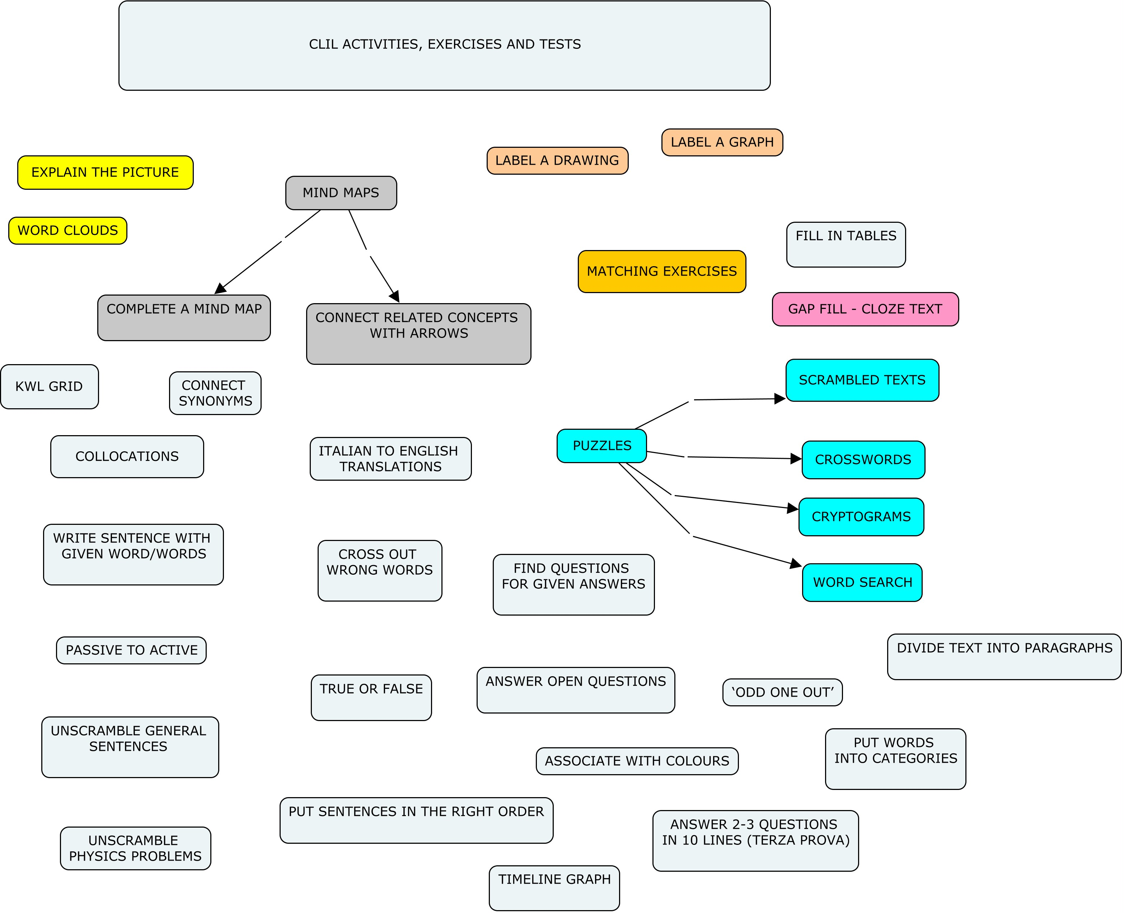

Slide 40
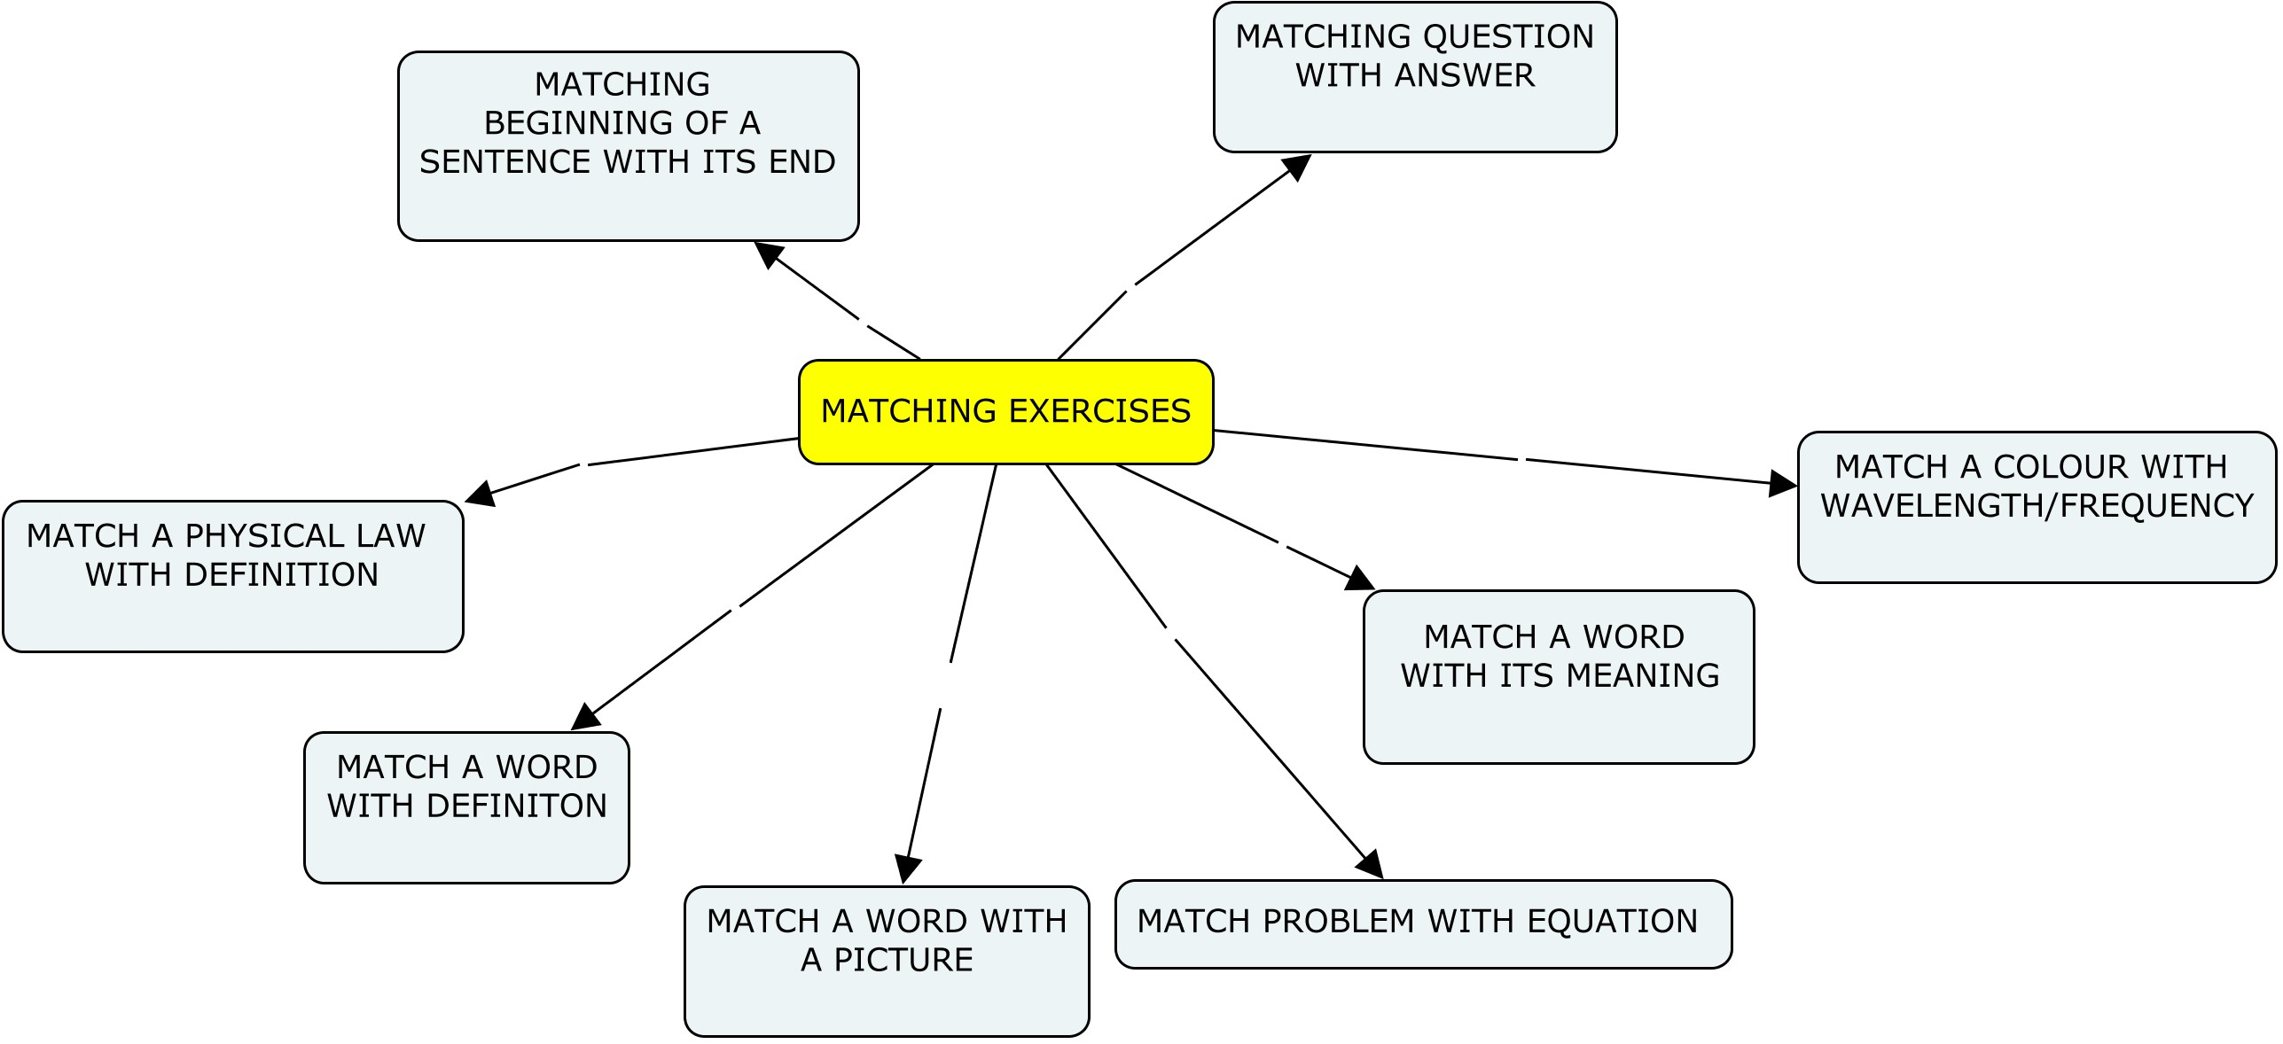

Slide 41
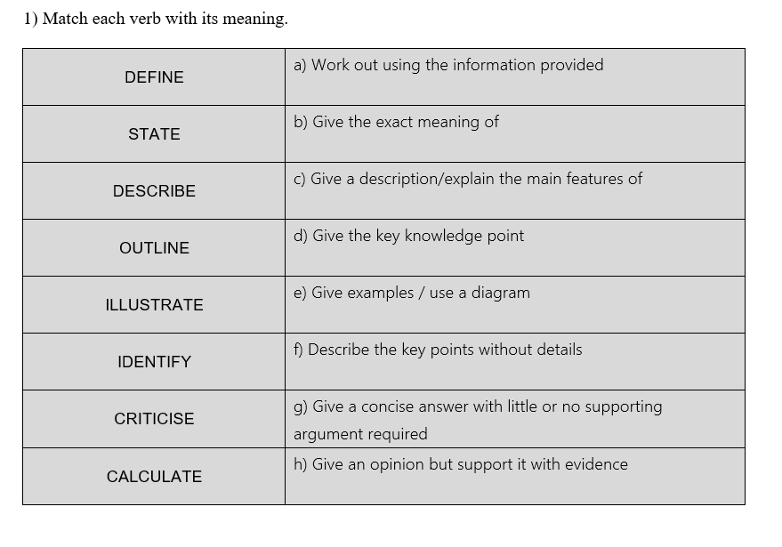
MATCHING EXERCISES
MATCH A WORD WITH ITS MEANING

Slide 42
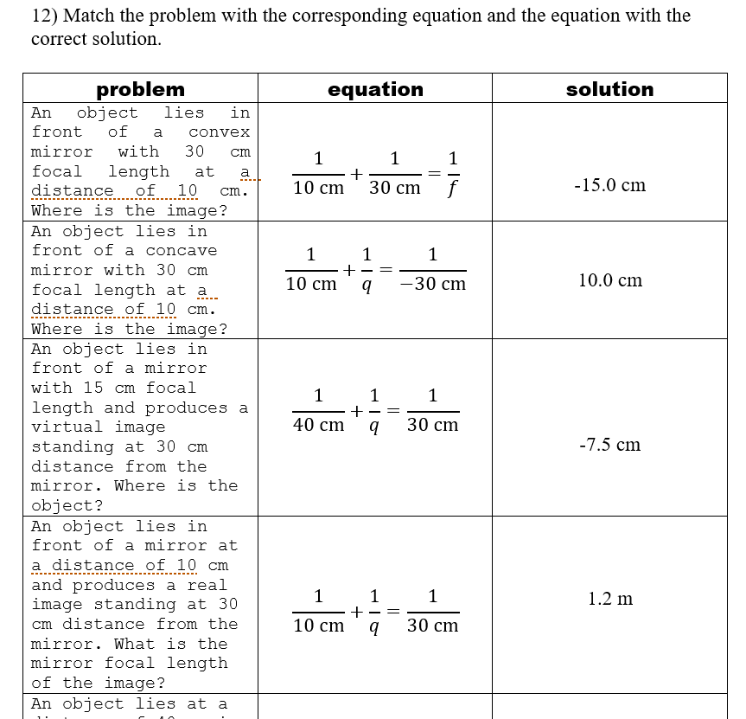
MATCHING EXERCISES
MATCH A PROBLEM WITH THE
CORRESPONDING EQUATION
AND WITH THE SOLUTION
THIS IS A GUIDED APPROACH TO
TRADITIONAL PHYSICS PROBLEMS

Slide 43
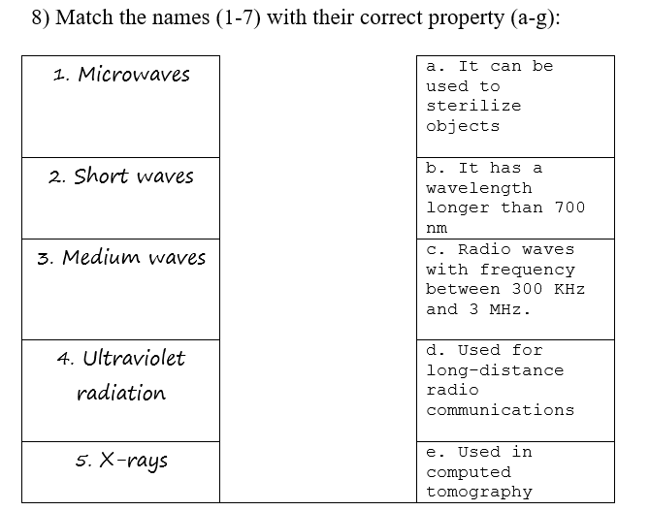
MATCHING EXERCISES
MATCH A WORD
WITH ITS DEFINITON

Slide 44
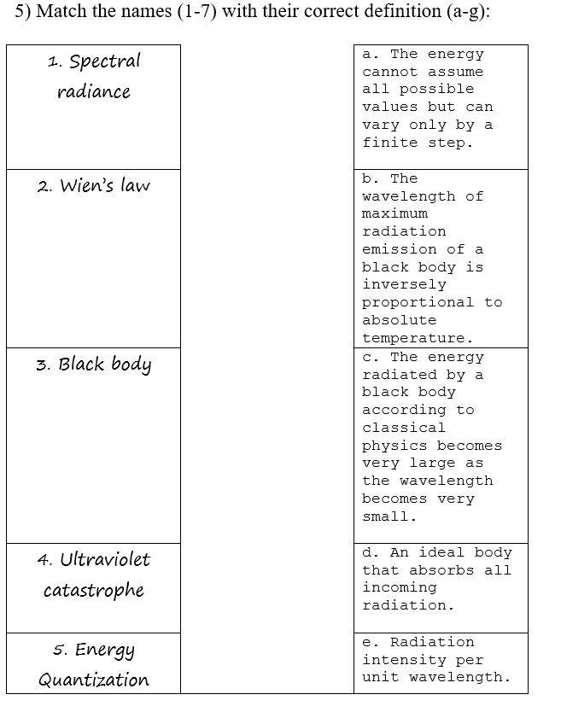
MATCHING EXERCISES
MATCH A PHYSICAL LAW WITH ITS
CORRECT DEFINITION

Slide 45
MATCHING EXERCISES
MATCH A COLOUR WITH
ITS WAVELENGTH/FREQUENCY

Slide 46
MATCHING EXERCISES
MATCH LAMP TYPE WITH COLOUR
TEMPERATURE

Slide 47
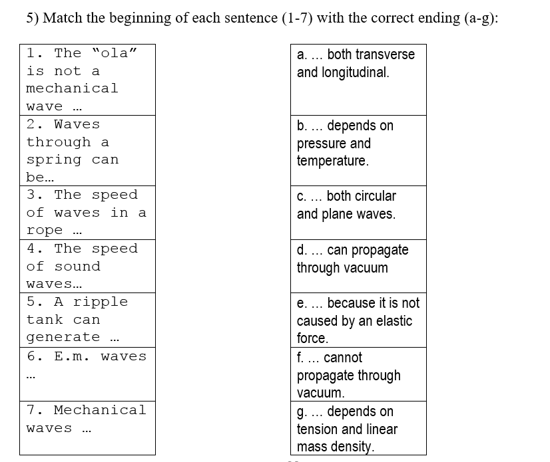
MATCHING EXERCISES
MATCH THE
BEGINNING OF A
SENTENCE WITH ITS END

Slide 48
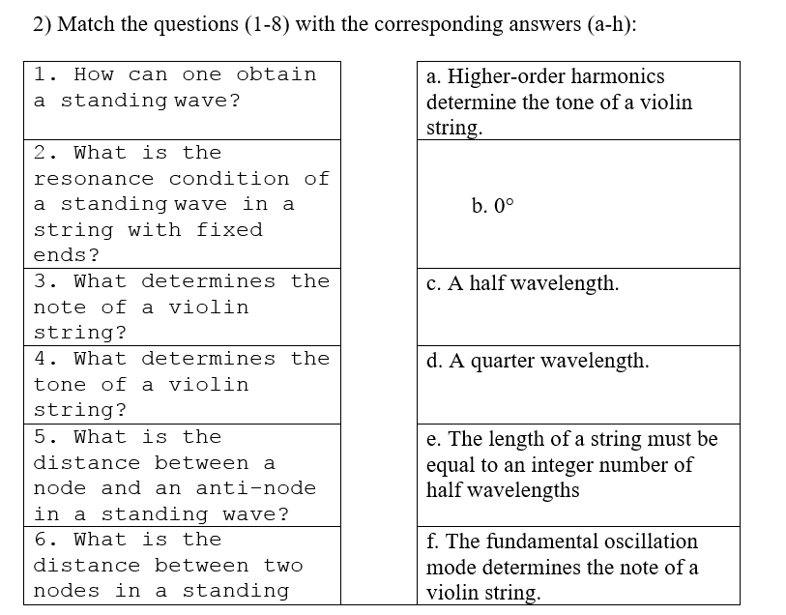
MATCHING EXERCISES
MATCH A QUESTION
WITH ITS ANSWER

Slide 49
MATCHING EXERCISES
MATCH A WORD WITH
A PICTURE

Slide 50
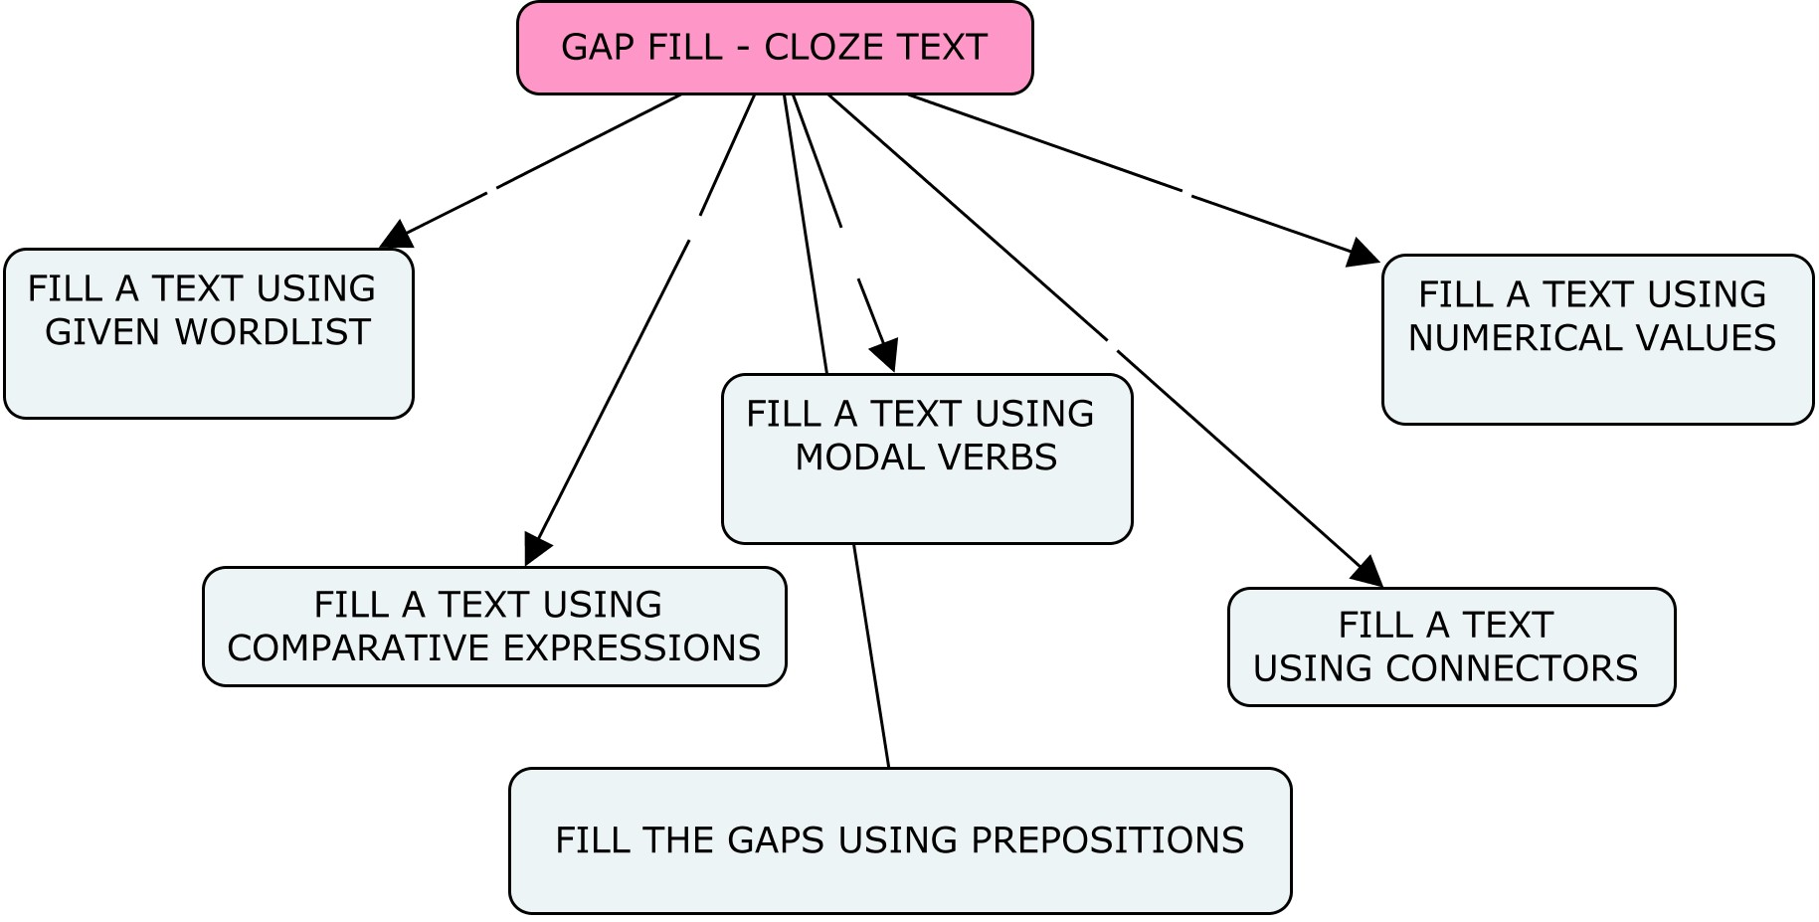
GAP FILL EXERCISES

Slide 51
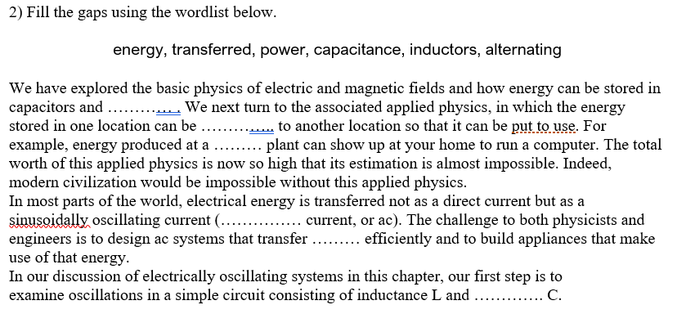
GAP FILL EXERCISES
FILL A TEXT WITH OR WITHOUT A GIVEN WORDLIST

Slide 52
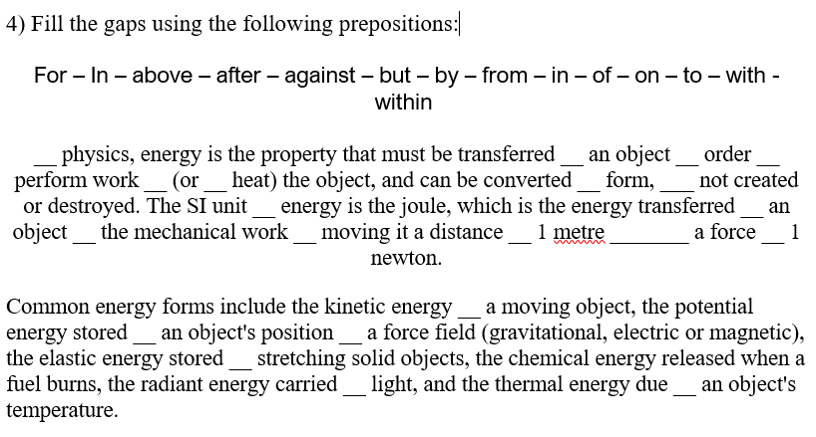
GAP FILL EXERCISES
FILL A TEXT USING PREPOSITIONS

Slide 53
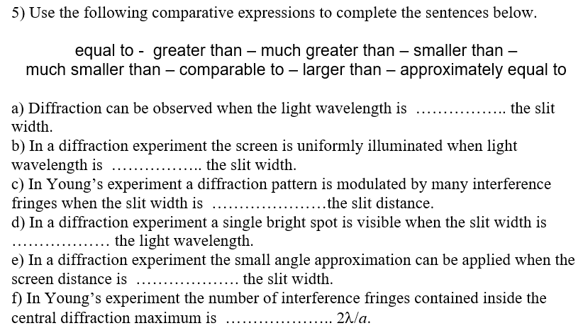
GAP FILL EXERCISES
FILL A TEXT USING COMPARATIVE EXPRESSIONS, MODAL VERBS,…

Slide 54
GAP FILL EXERCISES
FILL A TEXT USING CONNECTORS (LINKERS)

Slide 55
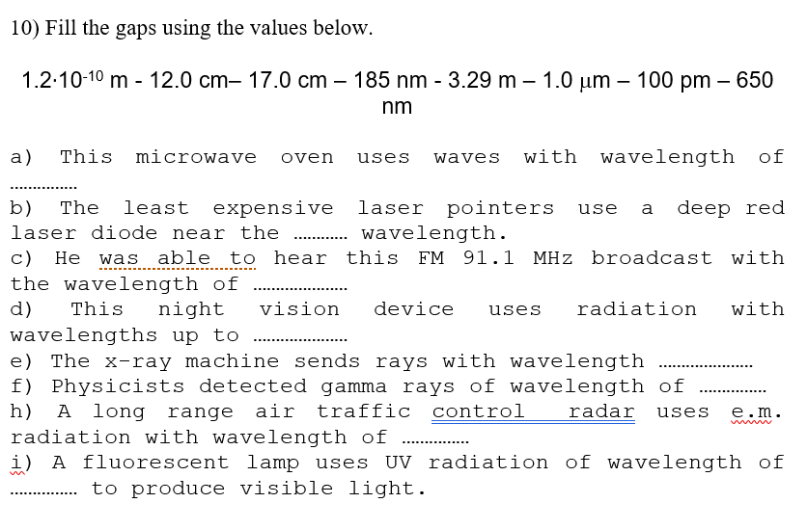
GAP FILL EXERCISES
FILL A TEXT USING NUMERICAL VALUES

Slide 56
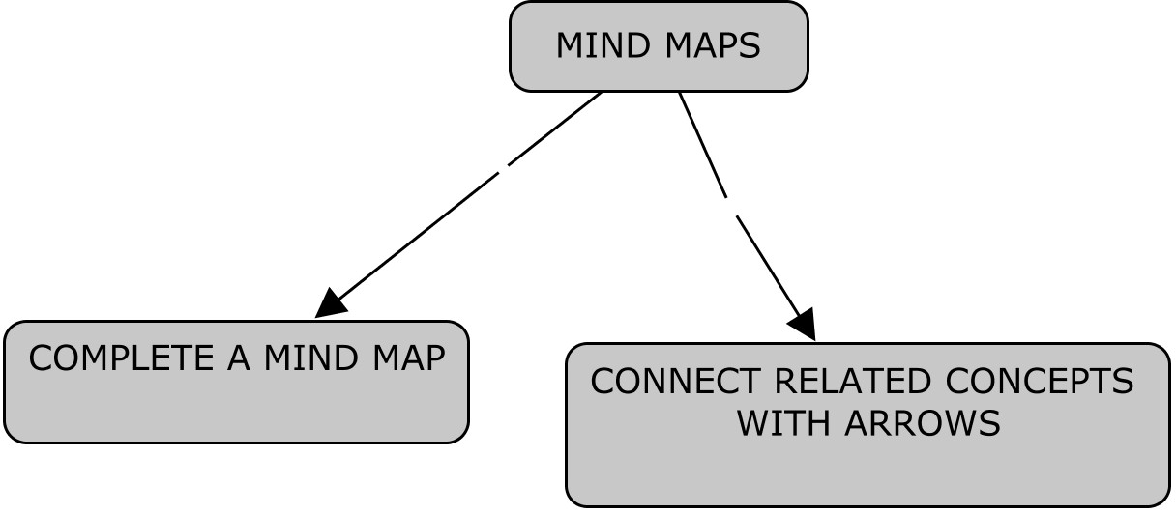
MIND MAPS

Slide 57
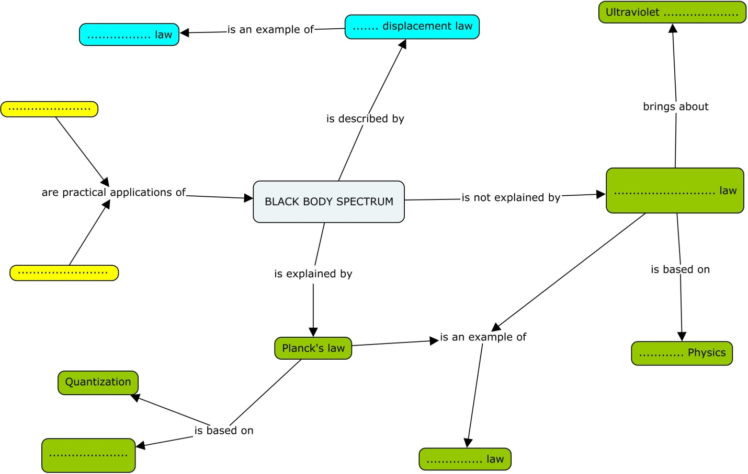
MIND MAPS
COMPLETE A MIND MAP

Slide 58
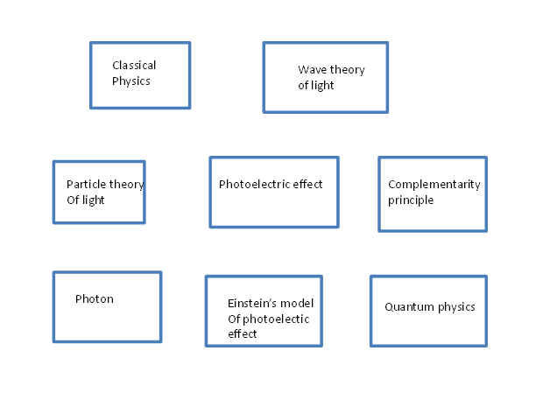
MIND MAPS
CONNECT RELATED CONCEPTS WITH ARROWS

Slide 59
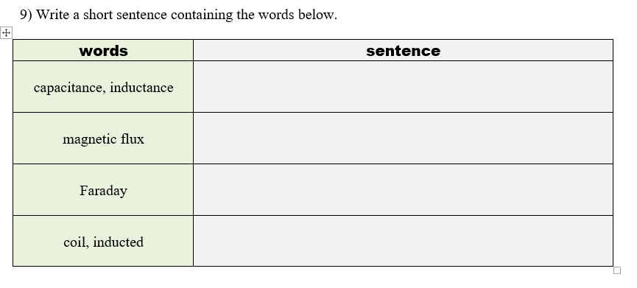
WRITE A SENTENCE FOR EACH GIVEN WORD
WRITE A SENTENCE CONTAINING GIVEN WORD/WORDS

Slide 60
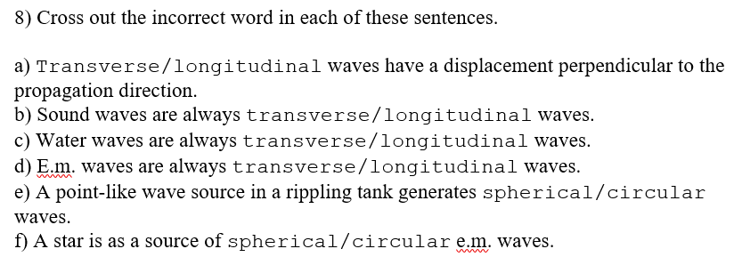
CROSS OUT
CROSS OUT WRONG WORDS

Slide 61
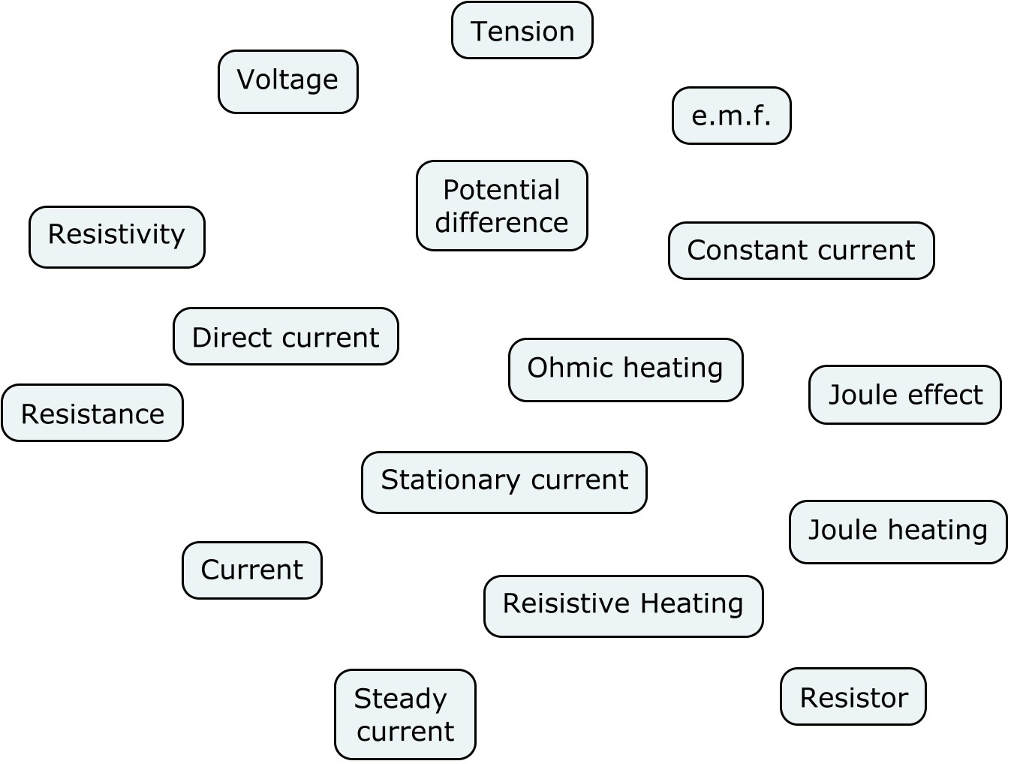
CONNECT SYNONYMS
CONNECT SYNONYMS WITH A DOUBLE LINE AND RELATED WORDS WITH A LINE

Slide 62
TRUE OR FALSE
TRUE OR FALSE

Slide 63
FIND QUESTIONS
FIND QUESTIONS CORRESPONDING TO GIVEN ANSWERS

Slide 64
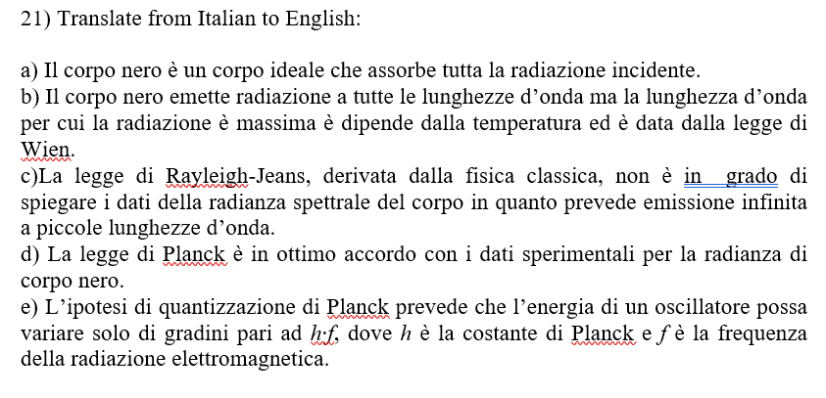
CLIL ACTIVITIES
ANSWER OPEN QUESTIONS
ITALIAN TO ENGLISH
TRANSLATIONS

Slide 65
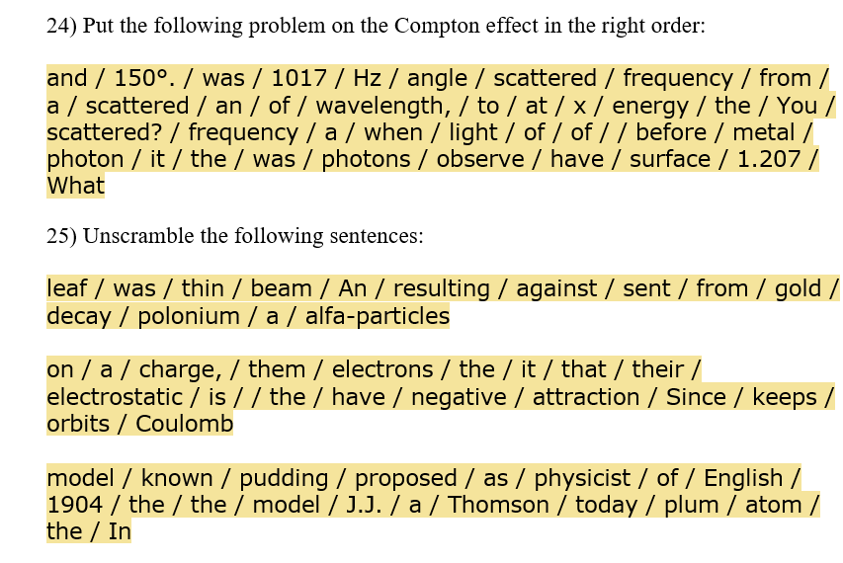
SENTENCE UNSCRAMBLE
UNSCRAMBLE SENTENCES OR PHYSICS PROBLEMS – MORE EFFECTIVE WITH THE MOODLE PLATFORM
IF THE SENTENCE IS LONG , IT MAY BE VERY HARD TO SOLVE

Slide 66
REORDER PARAGRAPH
PUT SENTENCES IN THE RIGHT ORDER

Slide 67
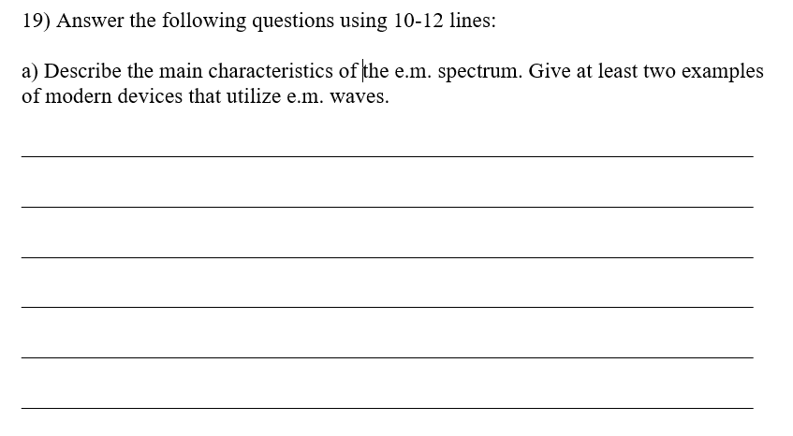
‘TERZA PROVA’
ANSWER 2-3 QUESTIONS IN 10 LINES (TERZA PROVA)

Slide 68
EXPLAIN THE PICTURE
ANSWER QUESTIONS ABOUT A PICTURE

Slide 69
LABEL A PICTURE
LABEL A PICTURE WITH THE CORRECT TERMS/DEFINITIONS

Slide 70
LABEL A GRAPH
LABEL A GRAPH WITH THE CORRECT TERMS/DEFINITIONS
a) Lower frequency same intensity
b) Photocell Voltage (V)
c) Stopping voltage
d) Photocurrent (μA)
e) Reference beam
f) Lower intensity same frequency
g) Saturation current

Slide 71
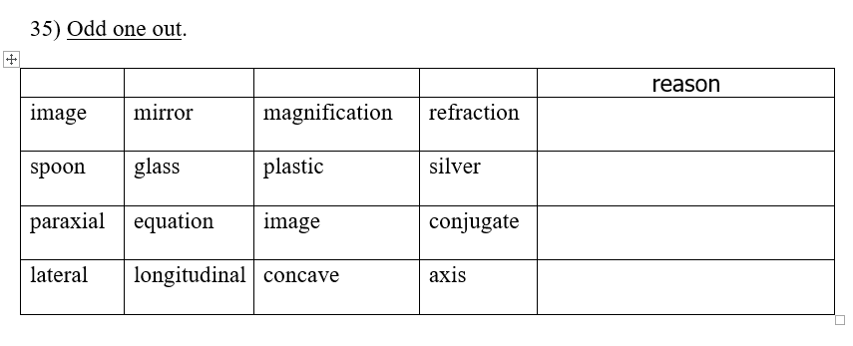
‘ODD ONE OUT’
ODD ONE OUT: CHOOSE THE WORD OUT OF PLACE AND EXPLAIN WHY. WORKS BEST WHEN CONCEPTS ARE SIMILAR

Slide 72
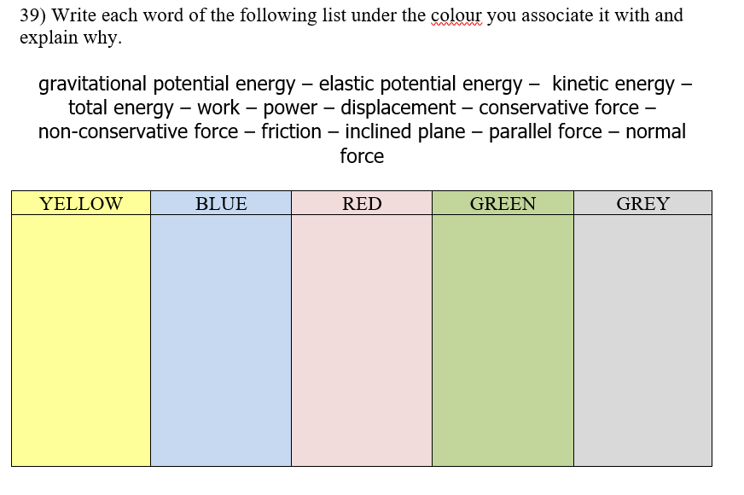
ASSOCIATE WITH COLOURS
ASSOCIATE WORDS AND CONCEPTS WITH COLOURS

Slide 73
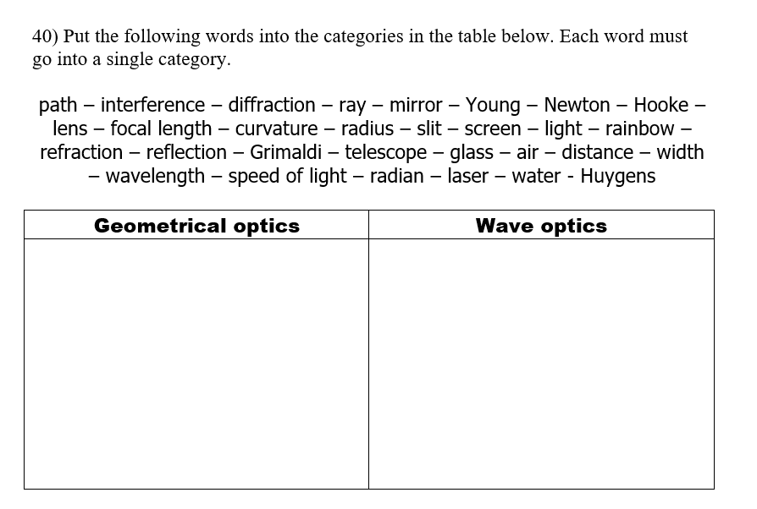
CATEGORIES
PUT WORDS INTO CATEGORIES

Slide 74
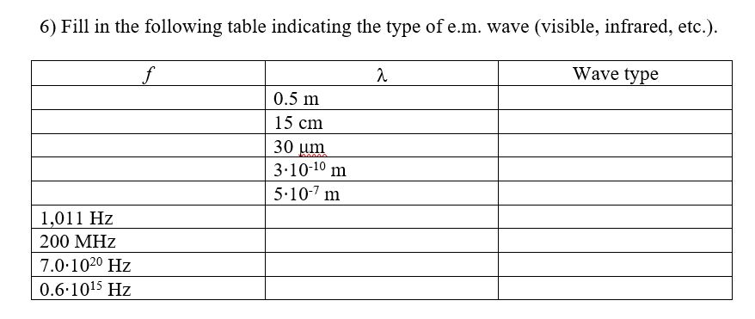
TABLES
FILL IN TABLES – REQUIRES SIMPLE COMPUTATIONS

Slide 75
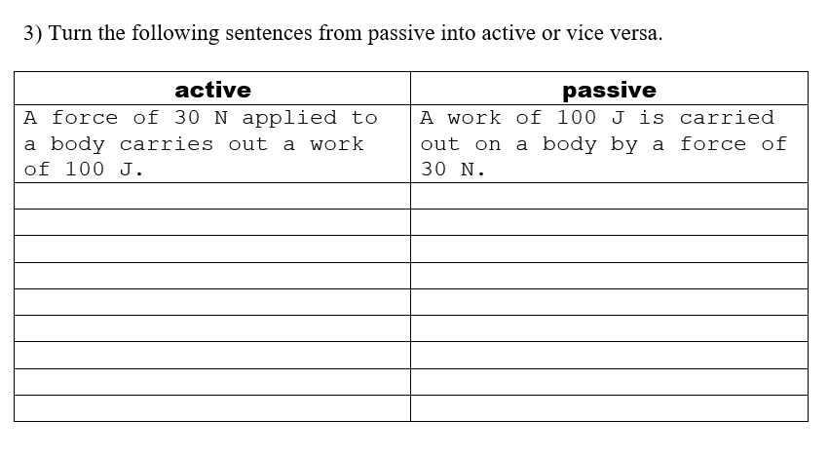
PASSIVE TO ACTIVE
TURN SENTENCES FROM PASSIVE TO ACTIVE OR VICEVERSA

Slide 76
GRAMMATICAL METAPHORS
PARAPHRASE GRAMMATICAL METAPHORS (ONLY FOR 5TH GRADE)
In academic written language, a word from one grammatical category is replaced by one
from a different category: for example nouns can be used instead of verbs to describe actions.

Slide 77
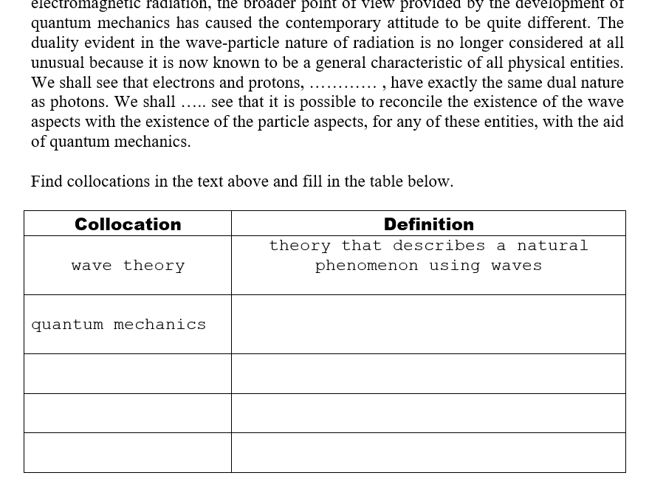
COLLOCATIONS
FIND COLLOCATIONS IN A GIVEN TEXT
“Collocations:
a pair or group of words that
are habitually used together.”

Slide 78
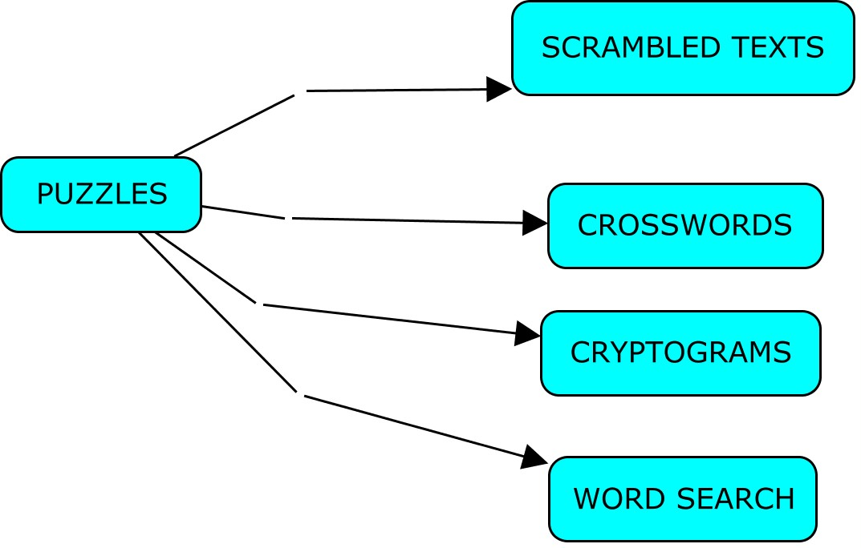

Slide 79
USEFUL PROGRAMS AND SITES
The Scramblinator : produces scrambled texts : http://www.altastic.com/scramblinator/
Cryptogram : produces cryptograms:
http://www.kidzone.ws/puzzles/cryptogram
The teacher’s corner: produces crossword puzzles and word search: https://worksheets.theteacherscorner.net/make-your-own/crossword/
Word clouds: http://www.wordclouds.com/
Cloze text creator: http://l.georges.online.fr/tools/cloze.html
Word search: produces word search on a theme: http://thewordsearch.com/cat/science/
CMAP TOOLS : produces mind maps, it is a stand alone program free to download and install

Slide 80
SENTENCE UNSCRAMBLE
The Scramblinator : produces scrambled texts : http://www.altastic.com/scramblinator/

Slide 81
CRYPTOGRAMS
http://www.kidzone.ws/puzzles/cryptogram

Slide 82
CROSSWORD PUZZLE
The teacher’s corner: produces crossword puzzles and word search: https://worksheets.theteacherscorner.net/make-your-own/crossword/

Slide 83
CROSSWORD PUZZLE

Slide 84
WORD CLOUDS
http://www.wordclouds.com/
WORD CLOUDS CAN BE USED TO
STIMULATE DISCUSSION AT THE
BEGINNING OF THE LESSON

Slide 85
CLOZE TEXTS – GAP FILL
A cloze test (also cloze deletion test) is an exercise, test, or assessment consisting of a portion of text with certain words removed (cloze text)
Cloze text creator: http://l.georges.online.fr/tools/cloze.html

Slide 86
WORD SEARCH
Word search: produces word search puzzles
on a theme:
http://thewordsearch.com/cat/science/

Slide 87
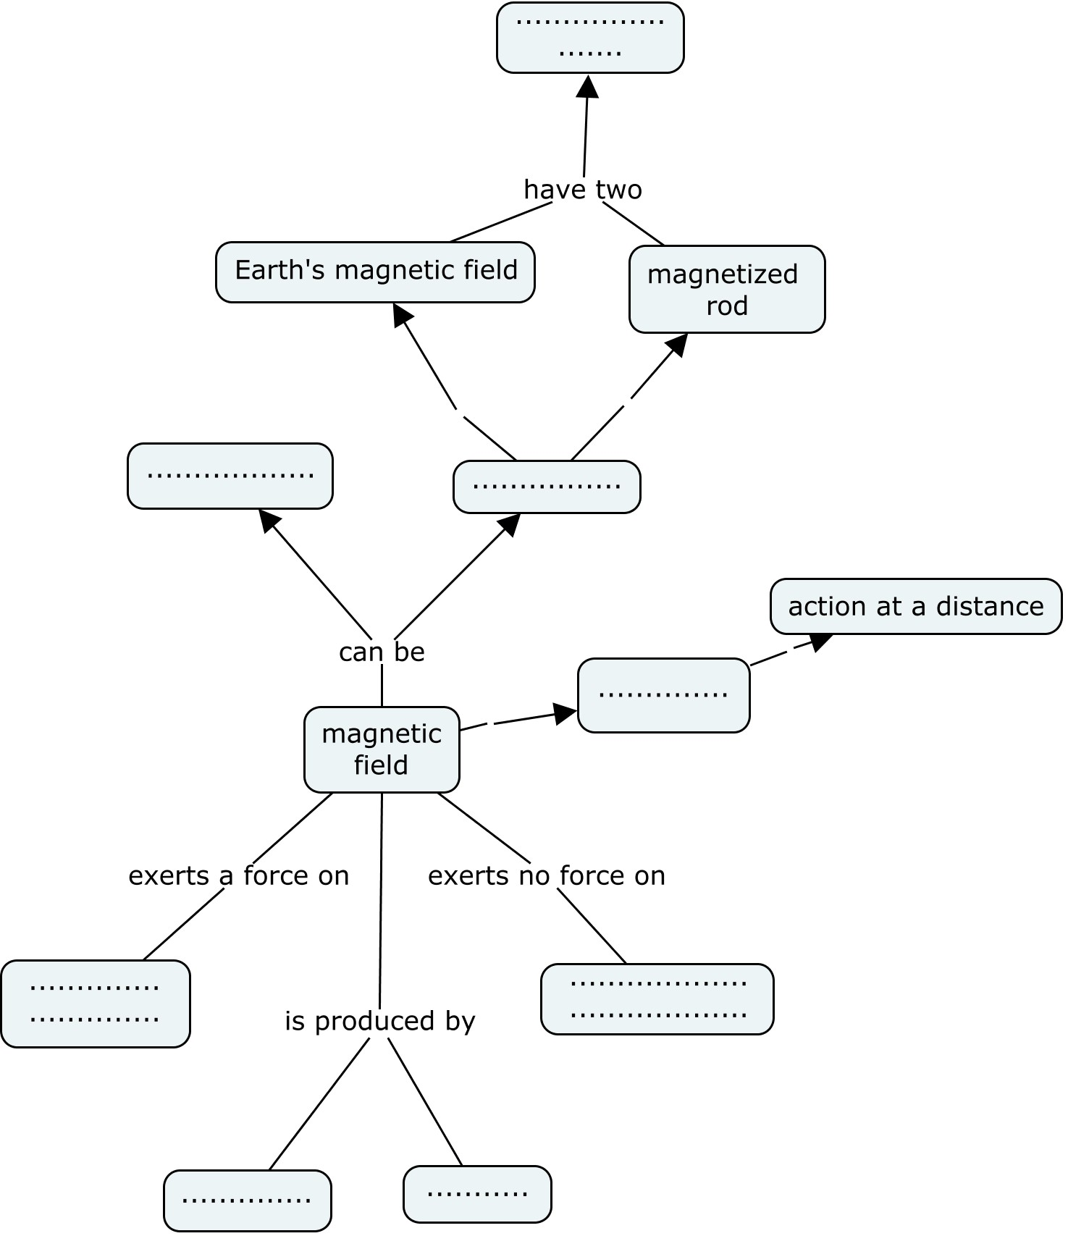
MIND MAPS
CMAP TOOLS:
PRODUCES MIND MAPS
THE PROGRAM IS FREE TO
DOWNLOAD AND INSTALL

Slide 88
5) TEXT OR VIDEO WITH ACTIVITIES

Slide 89
ORIGINAL TEXTS SHOULD BE USED
NOBEL LECTURES

Slide 90
VIDEOS
THERE ARE MANY SOURCES OF EDUCATIONAL VIDEOS ON THE WEB
KHAN ACADEMY
TED LESSONS
BOZEMAN SCIENCE
YOUTUBE (GENERAL SEARCH)

Slide 91
CLIL ACTIVITIES
AUTHENTIC VIDEOS AND TEXTS SHOULD ALWAYS BE USED IN EVERY CLIL LESSONS
HOWEVER, THEY MUST ALWAYS BE SUPPORTED BY ACTIVITIES AND TESTS

Slide 92
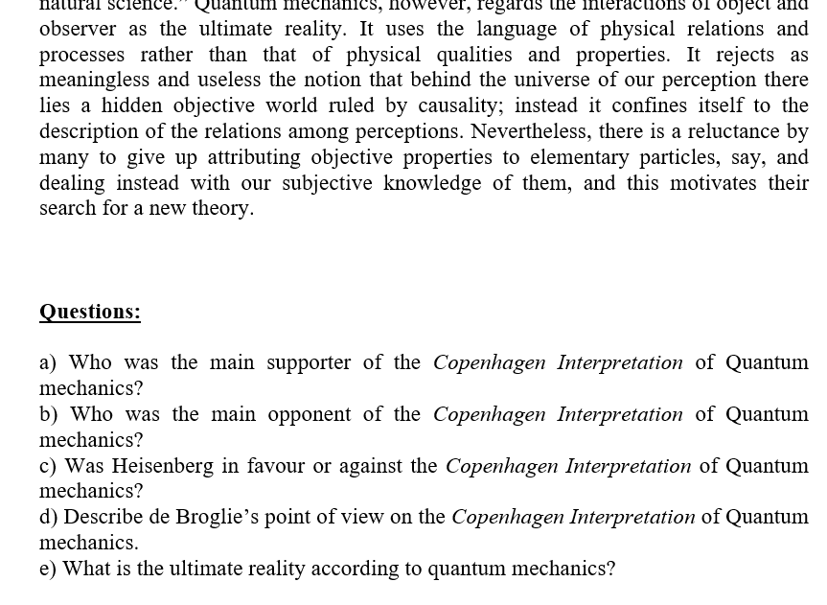
CLIL ACTIVITIES FOR TEXTS
ANSWER OPEN QUESTIONS ABOUT GIVEN TEXT

Slide 93
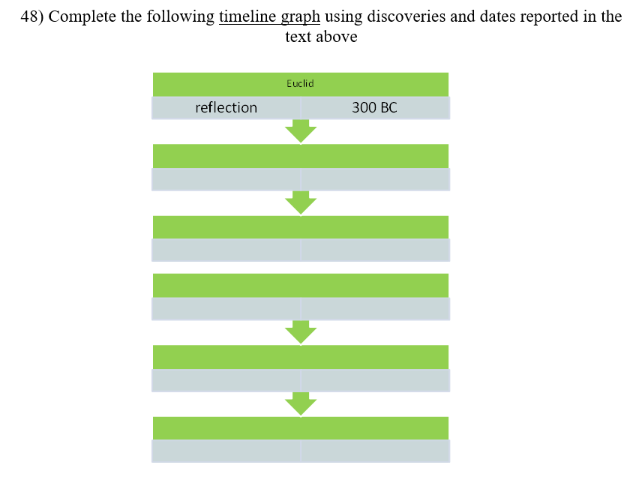
CLIL ACTIVITIES FOR TEXTS
TIMELINE GRAPH

Slide 94
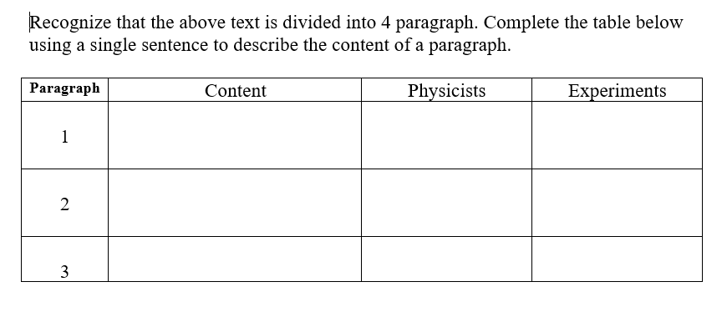
CLIL ACTIVITIES FOR TEXTS
DIVIDE TEXT INTO PARAGRAPHS

Slide 95
CLIL ACTIVITIES FOR VIDEOS
MATCHING EXERCISE ABOUT VIDEO CONTENT

Slide 96
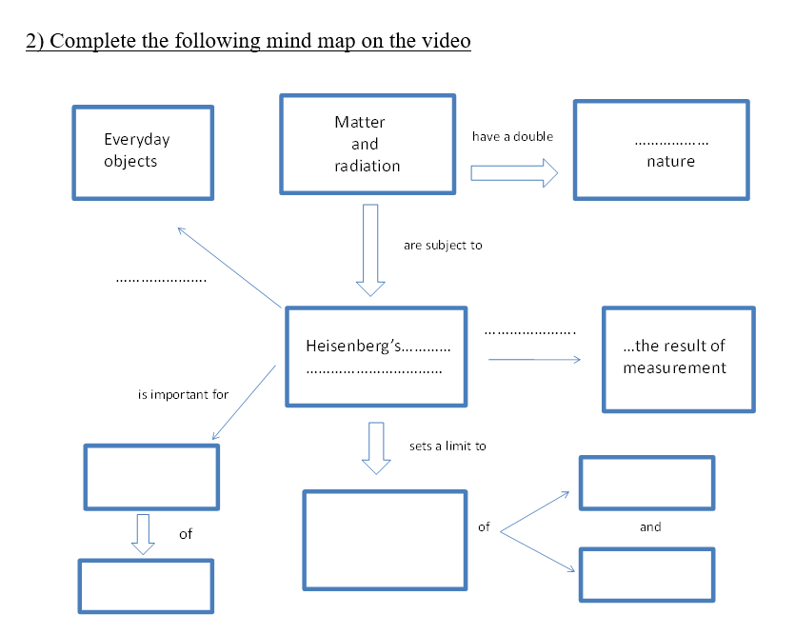
CLIL ACTIVITIES FOR VIDEOS
COMPLETE MIND MAP ON VIDEO

Slide 97
FINAL ASSESSMENT
THE ABOVE ACTIVITIES CAN ALSO BE USED FOR THE FINAL ASSESSMENT OF STUDENTS AFTER A SERIES OF LESSONS.
I HAVE USED UNTIL NOW THREE QUESTIONS TO BE ASWERED IN 10 LINES (TERZA PROVA)
THIS TEST HAS THE ADVANTAGE OF BEING ALREADY FAMILIAR TO STUDENTS, BUT IT REQUIRES AN APPROPRIATE EVALUATION GRID.

Slide 98
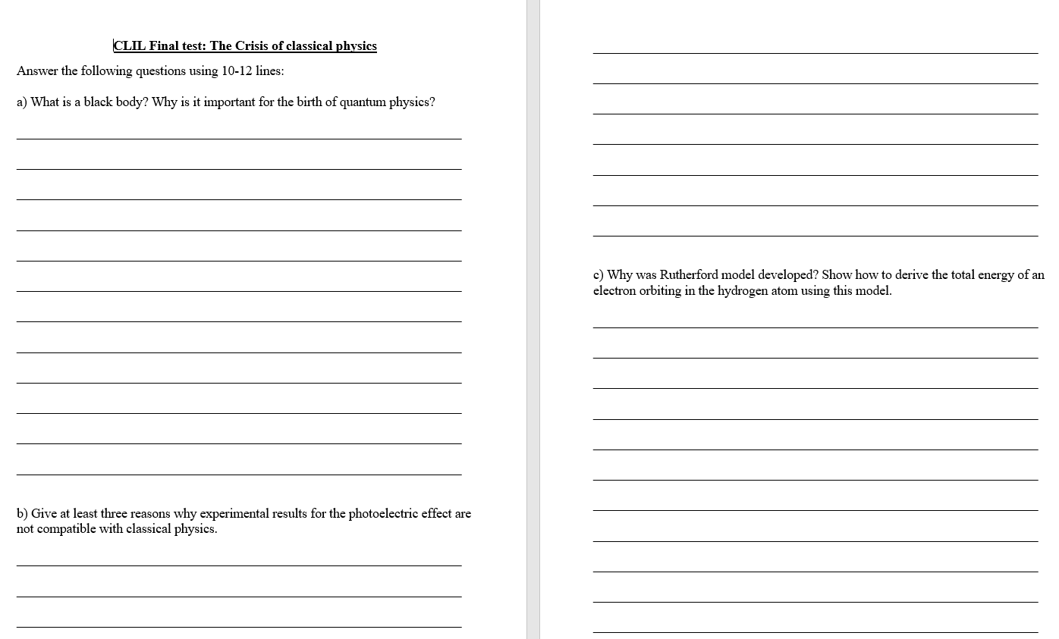
EXAMPLE OF FINAL TEST

Slide 99
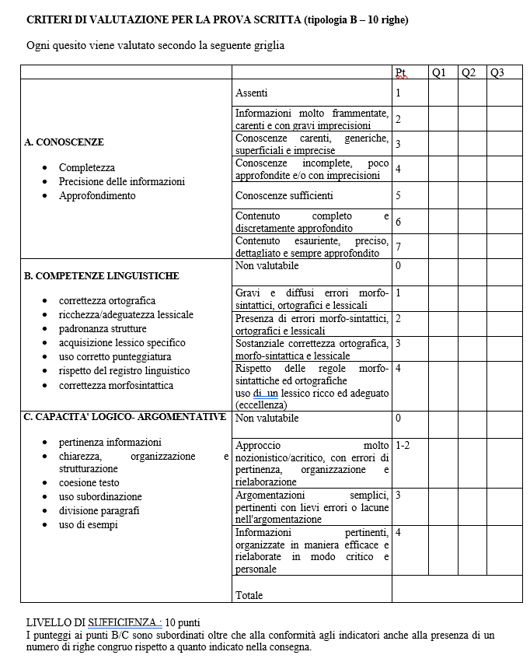
CLIL EVALUATION GRID
APPROXIMATELY 30% OF THE FINAL
SCORE DEPENDS ON LANGUAGE
KNOWLEDGE.
GRID DEVELOPED BY SCHOOL CLIL TEAM

Slide 100
CONCLUSIONS
ADVANTAGES OF THE CLIL APPROACH:
LEARN CURRICULAR SUBJECT AND IMPROVE ENGLISH AT THE SAME TIME
FULFILL LAW REQUIREMENTS
MORE INTUITIVE APPROACH TO SCHOOL SUBJECTS
DISADVANTAGES OF THE CLIL APPROACH
LESS DEEP SUBJECT KNOWLEDGE IS ACHIEVED
SPECIALIZED SUBJECTS SUCH AS MATHEMATICS AT LICEO SCIENTIFICO ARE DIFFICULT WITH CLIL

